Slide 1
Introduction to React, for Angular Developpers
Course Esilv 2024
arnaud.nauwynck@gmail.com
this document:
https://github.com/Arnaud-Nauwynck/Presentation/web/

Slide 2
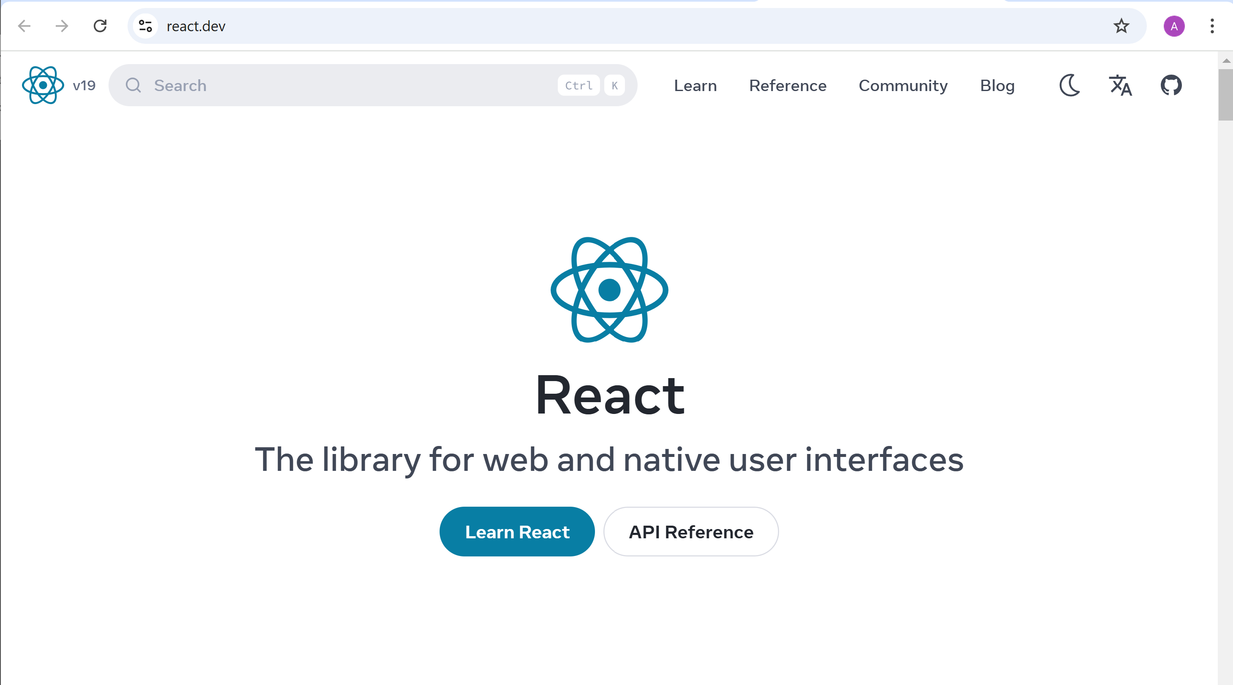
https://react.dev

Slide 3
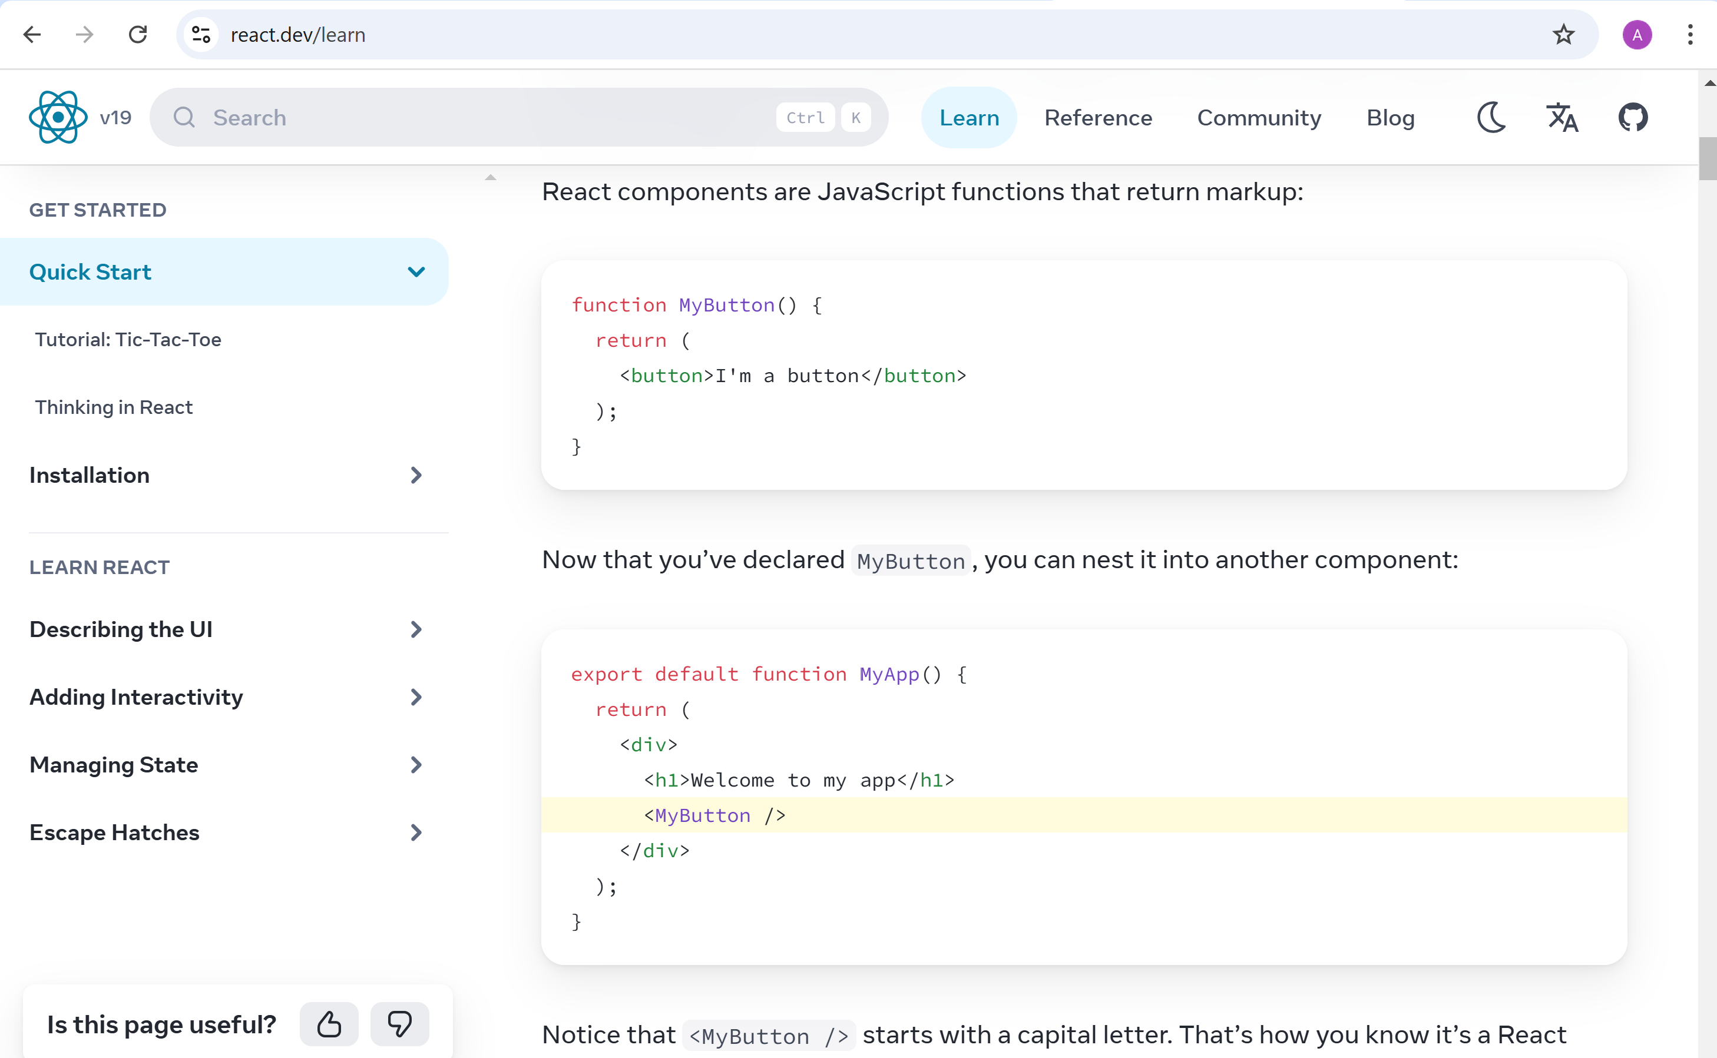
https://react.dev/learn

Slide 4
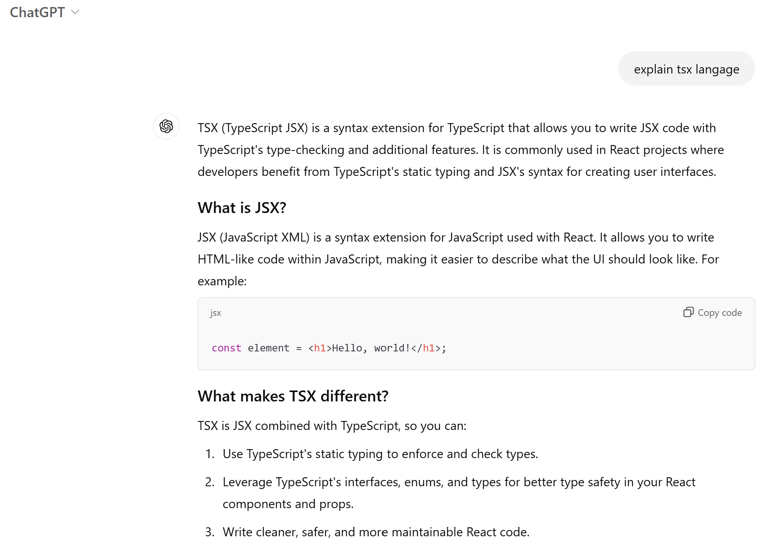
JSX, TSX ?

Slide 5
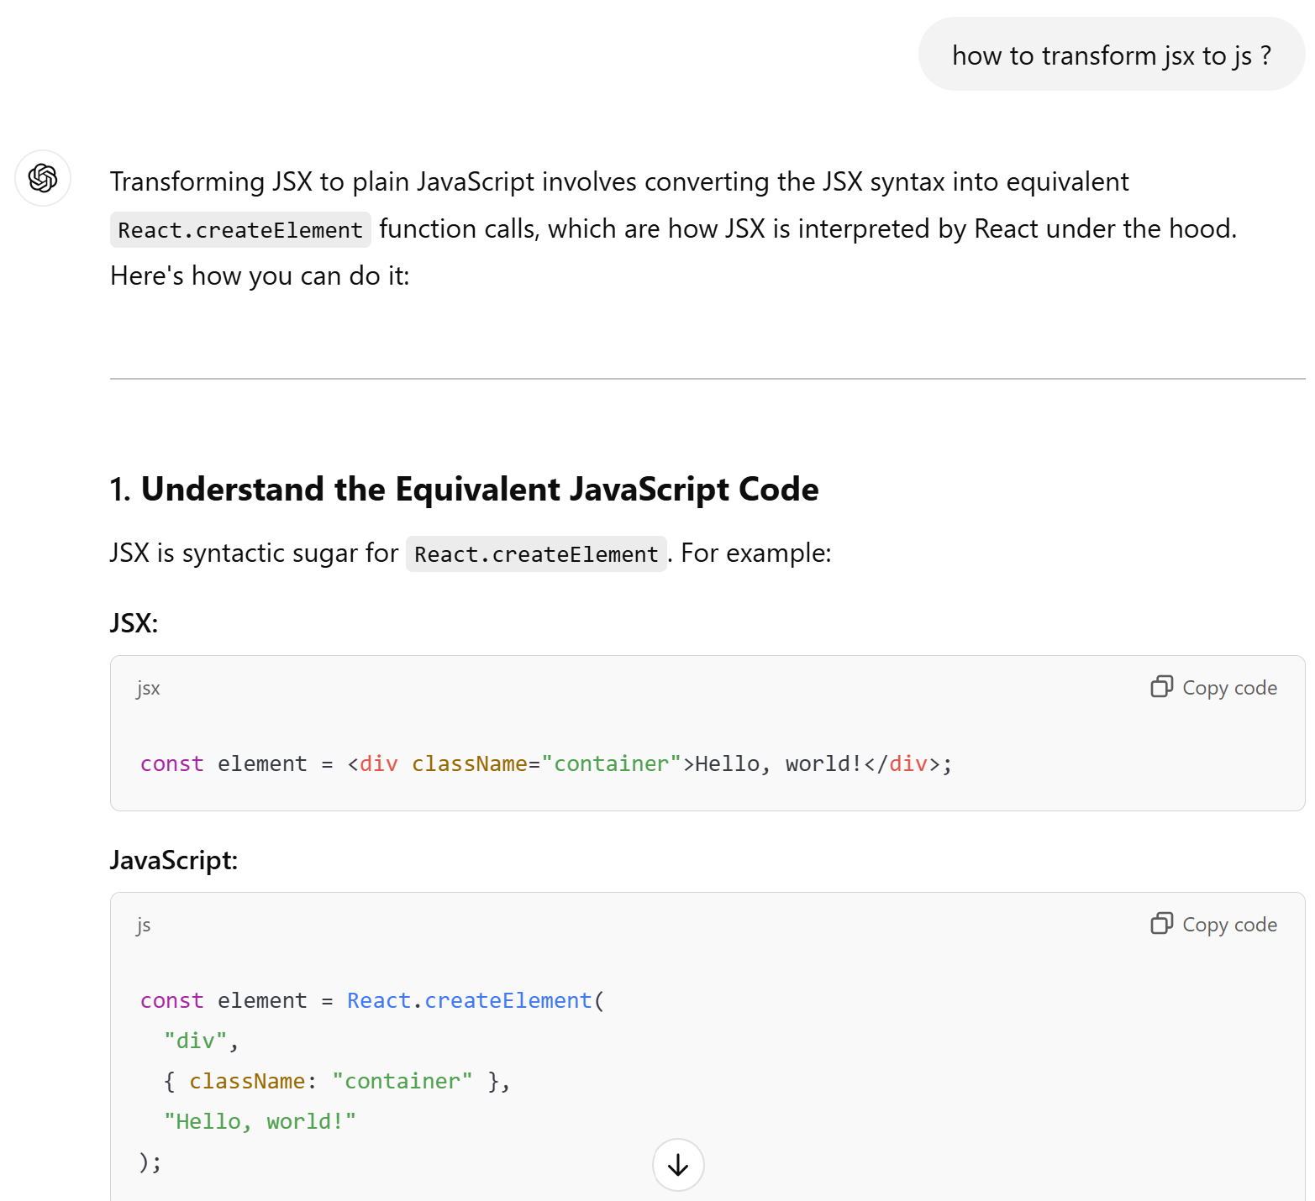
TSX -> TS + React runtime Virtual DOM

Slide 6
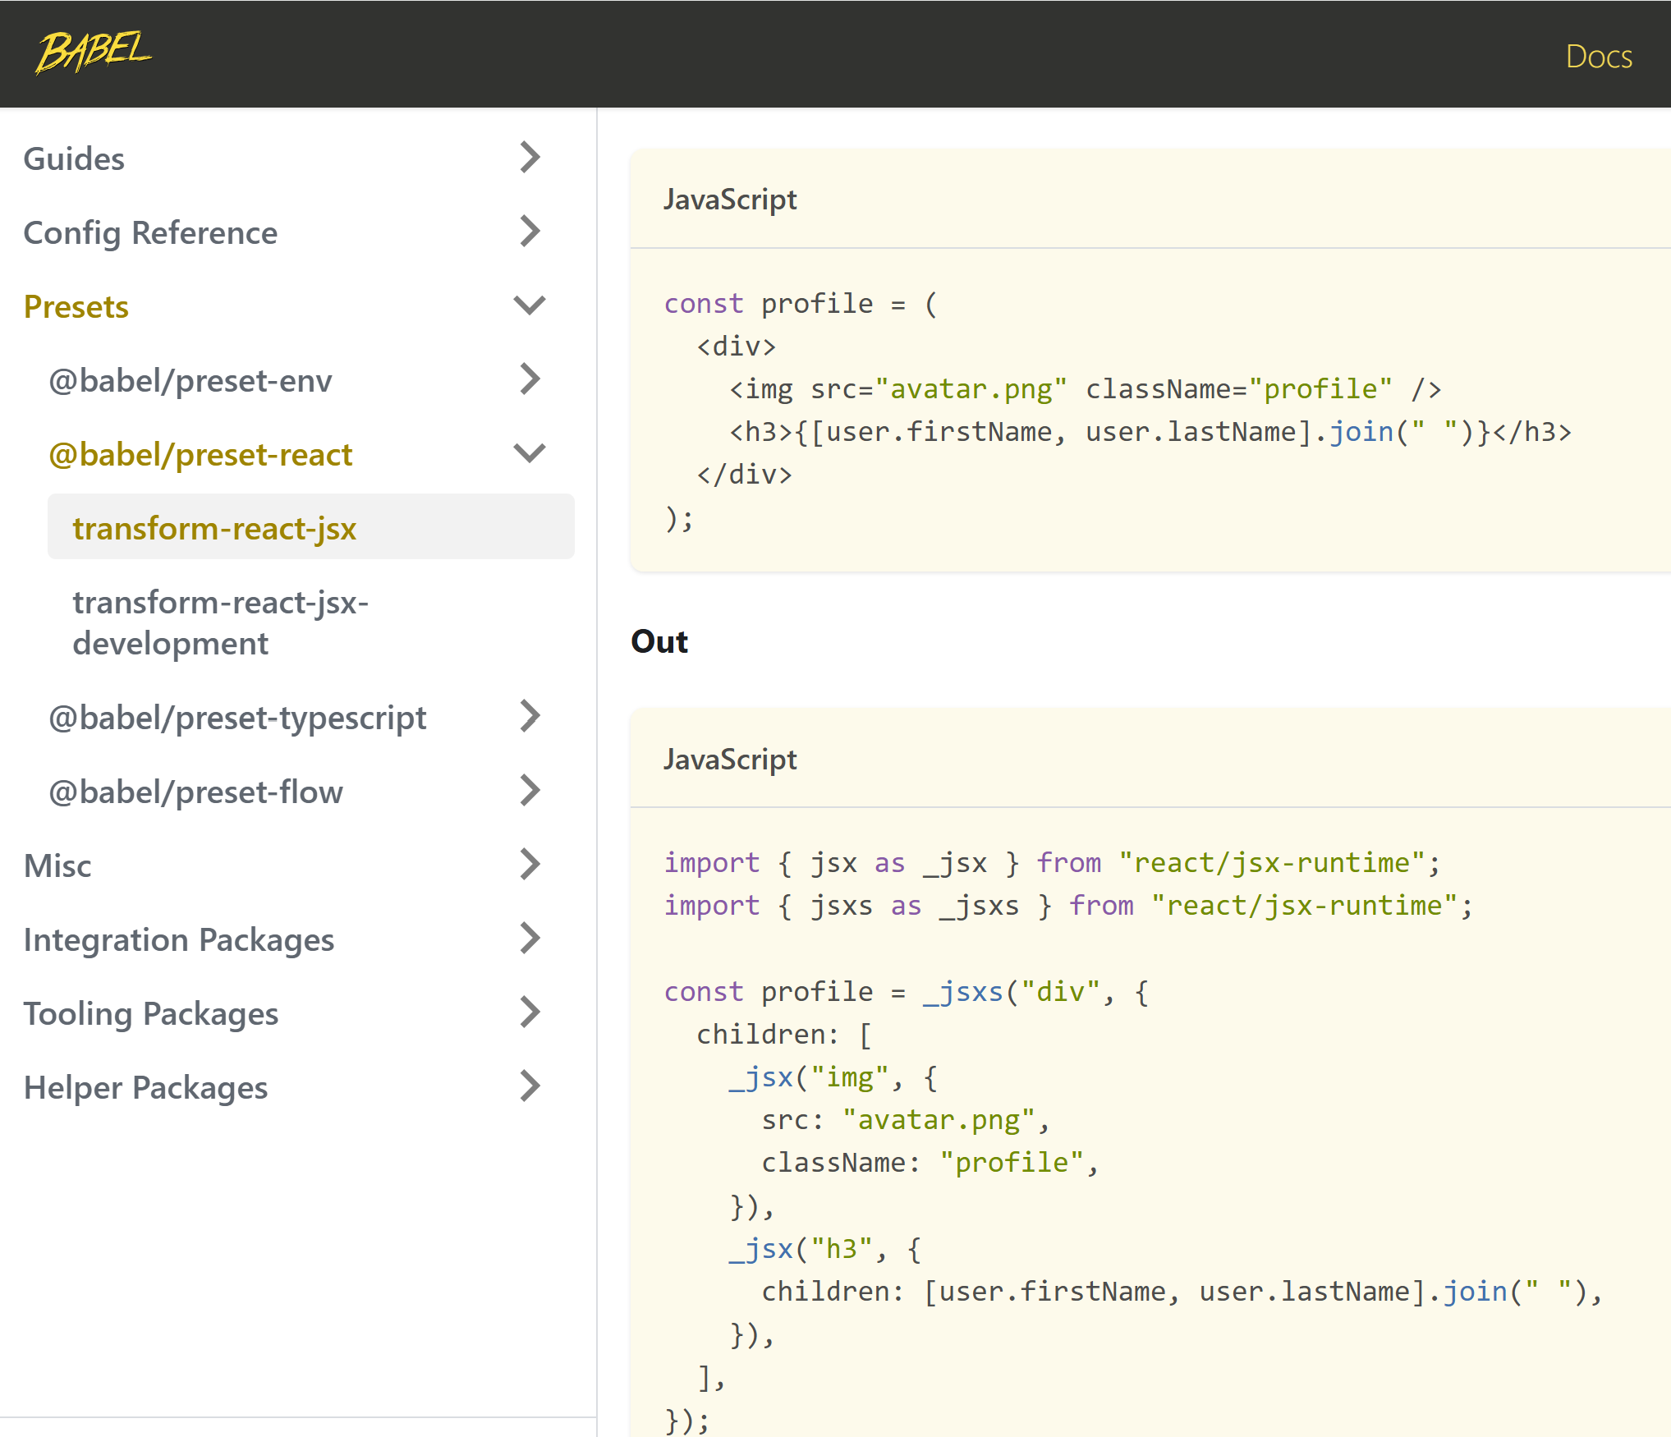
https://babeljs.io/docs/babel-plugin-transform-react-jsx

Slide 7
2 new langages mix of JS + HTML
TSX = extension of TS (Typescript) containing Html JSX = extension to JS (Javascript) containing Html
JSX is javascript that contains HTML <> ... </>
and nested HTML can contains <>{ javascript}<> !!
...which can contains sub-nested Html {<> .. </>}
... wich can contain Js: <>{ js.. <> { js } </> ...} </>

Slide 8

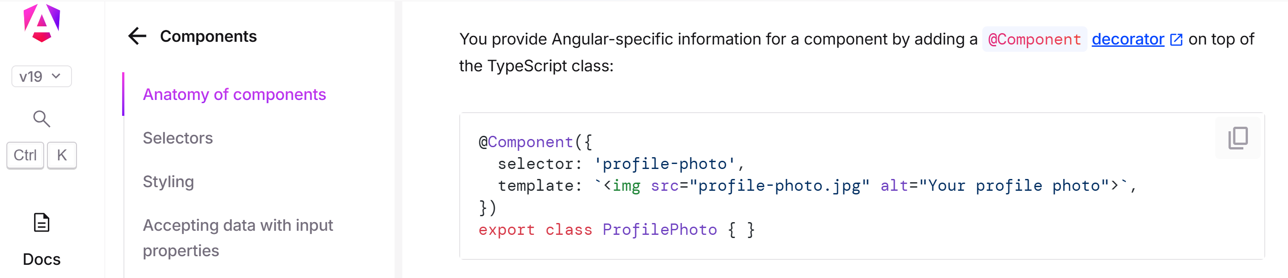
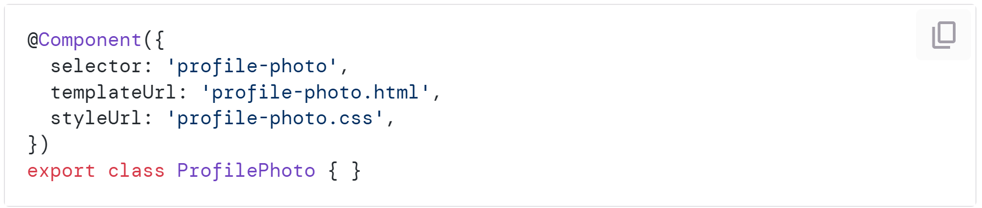

1 TSX File vs 1 ts or 1 ts+1 html Files
function ProfilePhoto() {
return <img src="profile-photo.jpg" alt="Your profile photo">;
}

Slide 9
Pros/Cons of 2 Files for Angular ?
Angular Html Templates are REAL Html syntaxicaly correct
(the *ngIf or @if() { ..} are just attribute / text in plain old html)
++ having 2 files with extension is better supported by all IDE
-- It is overkill for component with few line(s)
-- templateHtml='<div>..</div>' is not supported by all IDE as Html
-- TSX / TSX : neither valid Typescript, nor valid HTML.
merge of both langages, require special IDE support

Slide 10
Create a New React Project
try 1 : tested official doc React + Next.JS Framework npx create-next-app
next dev ... FAILED
try 2 : tested npx create-react-app npm install ... FAILED
try 3 : tested IDEA > New Project
Run ... FAILED

Slide 11
new project using React + Next.Js

Slide 12
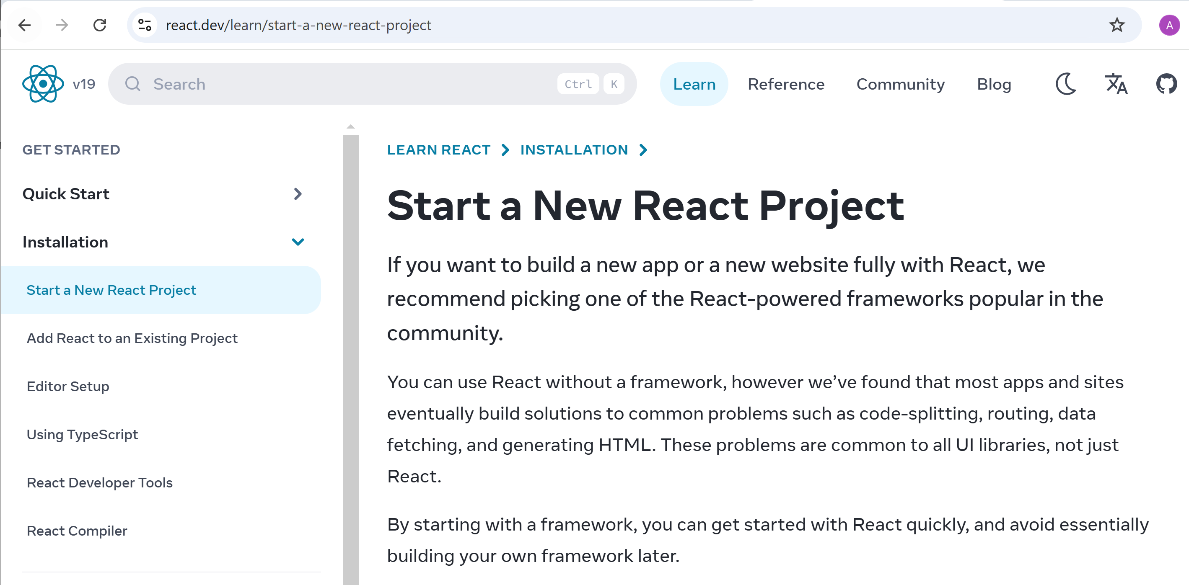
New React Project + choose a Framework

Slide 13

React is NOT enough, You need additional Framework(s) example: for Router, for state : Redux, better bindings : MOBX,..

Slide 14
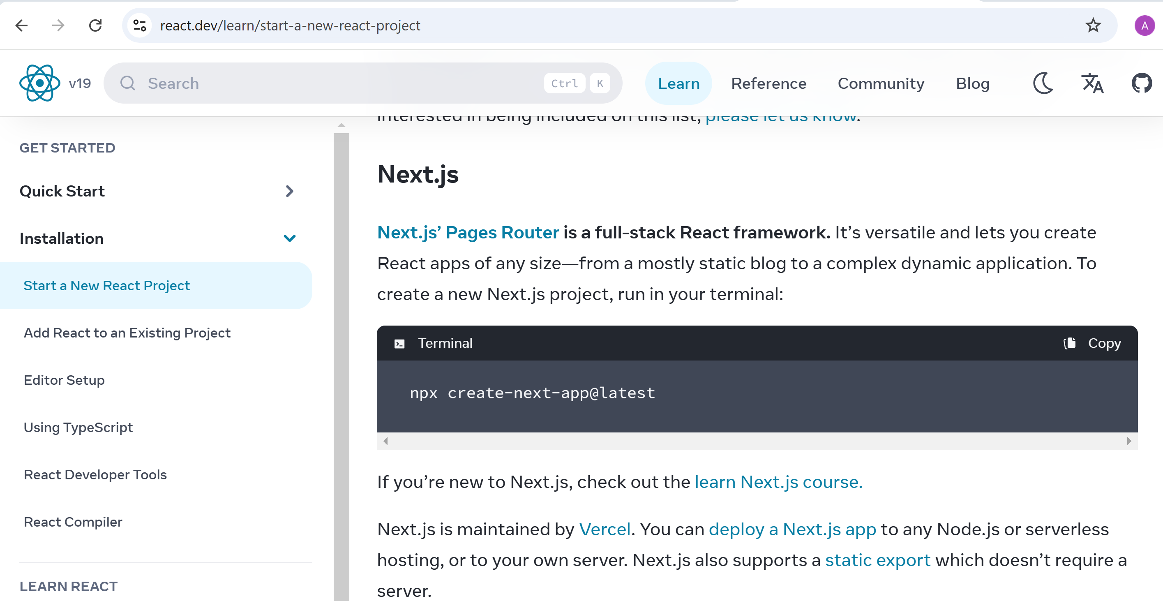
Next.JS

Slide 15
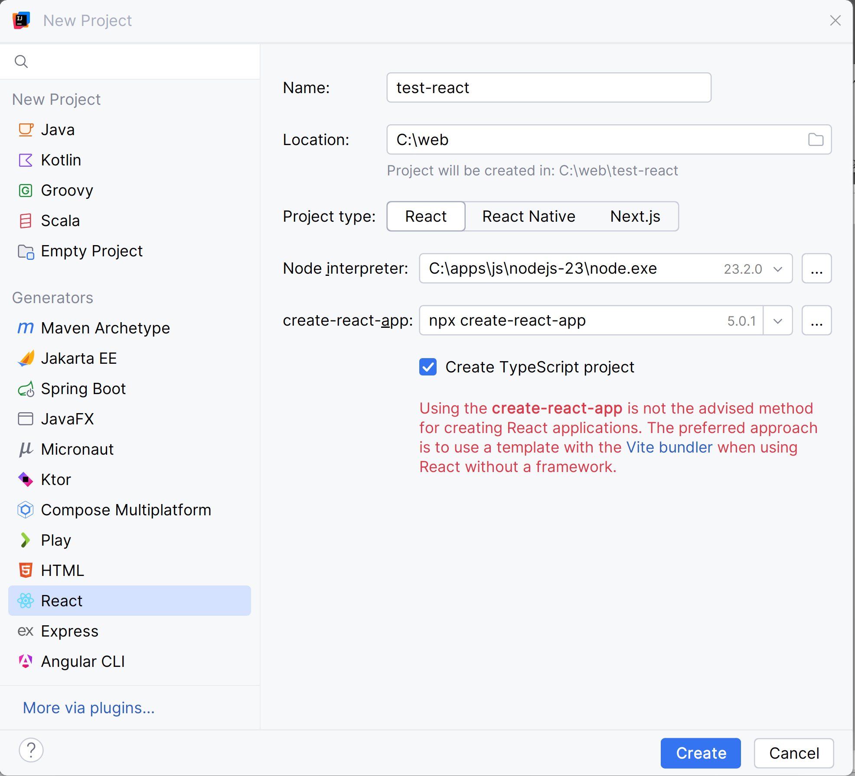
From Idea: New Project > "React"

Slide 16
Exploring a Minimal React App

Slide 17
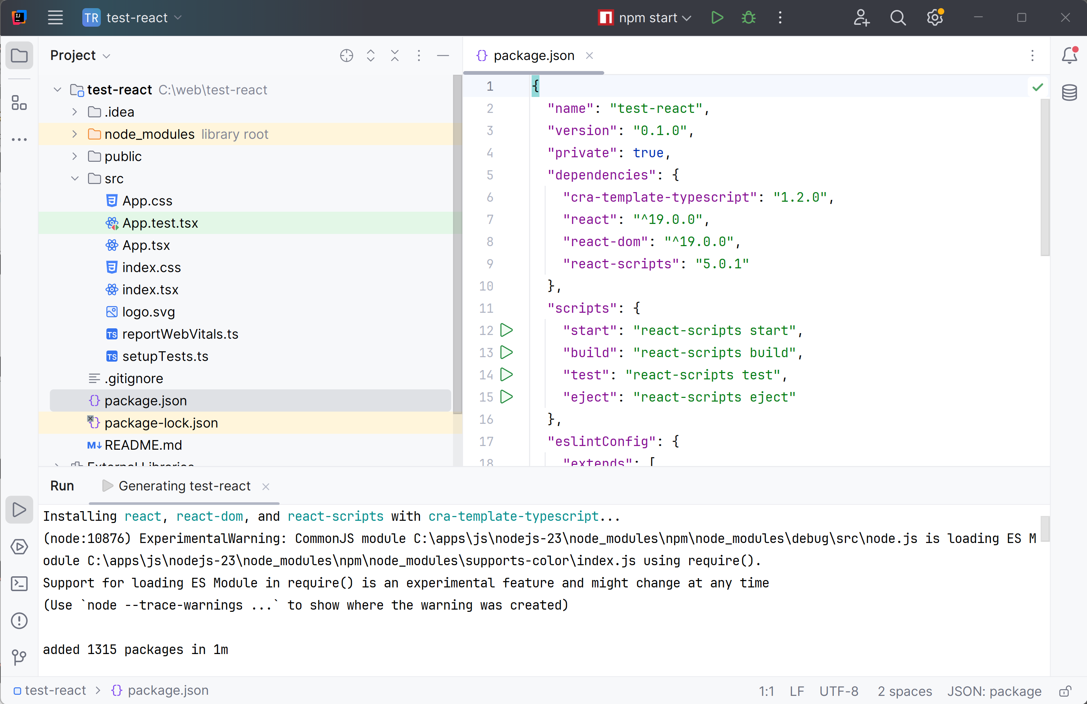
React Project

Slide 18
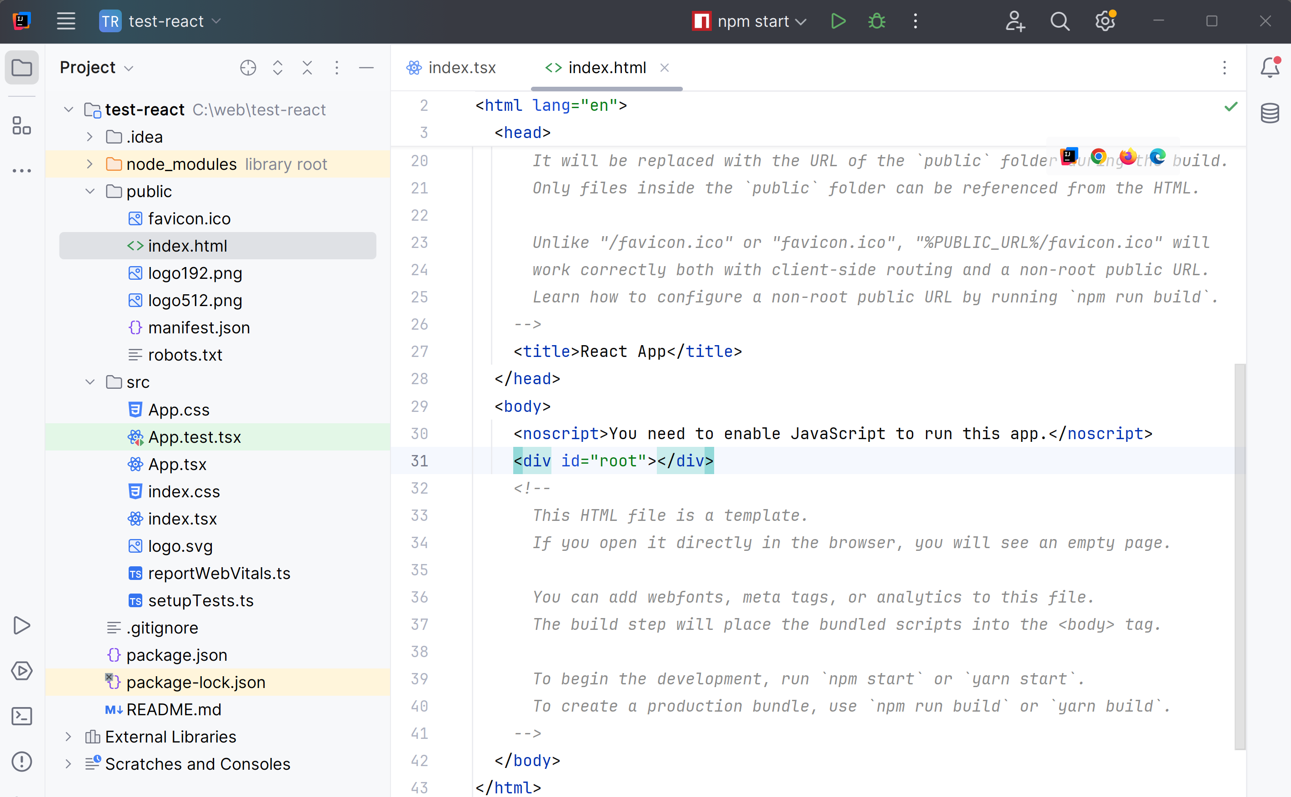
Index.html : Main Container for your App

Slide 19
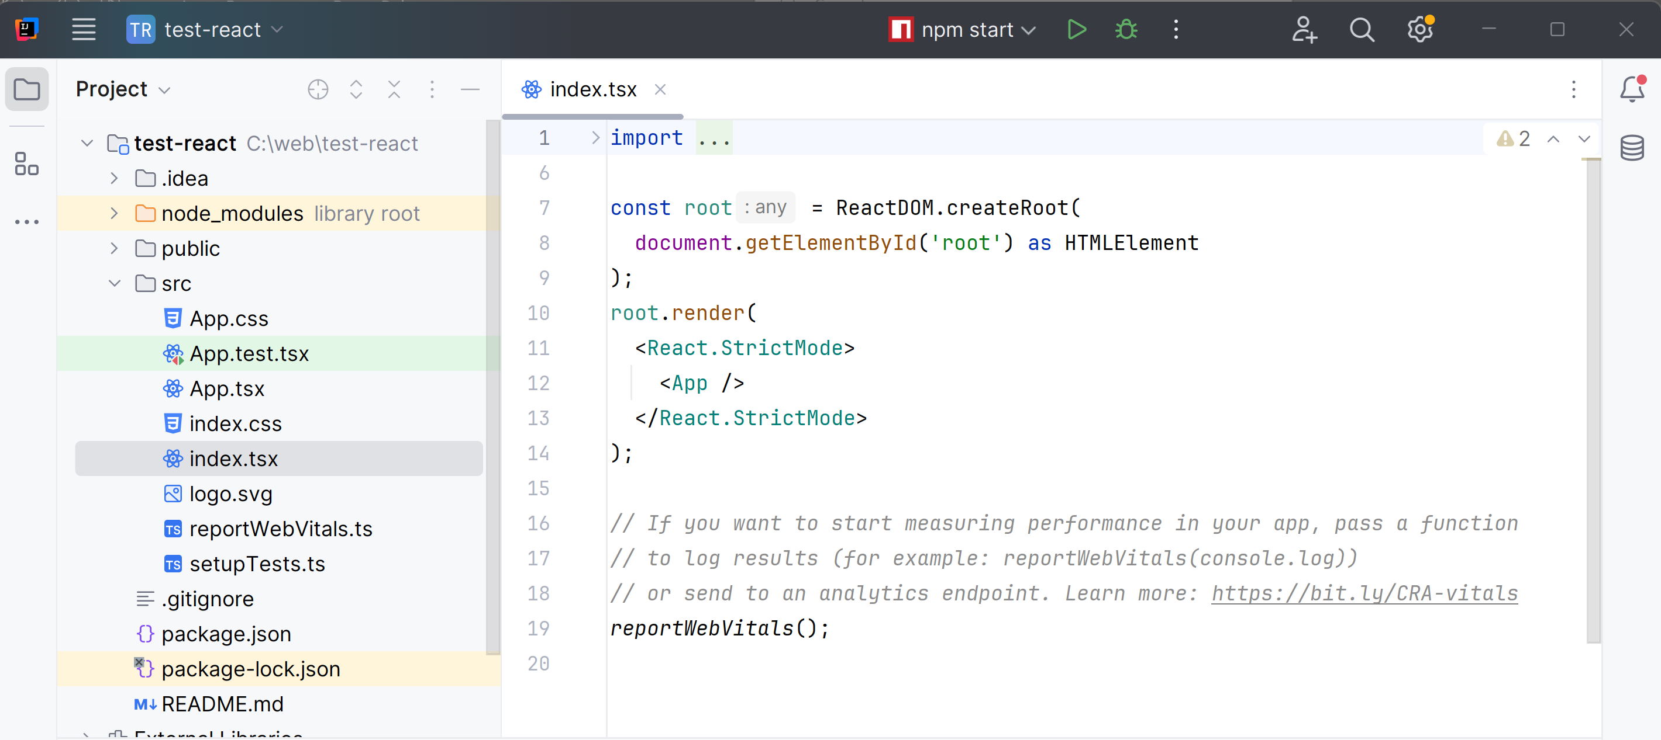
index.tsx : Bootstrapping ReactDOM.render()

Slide 20
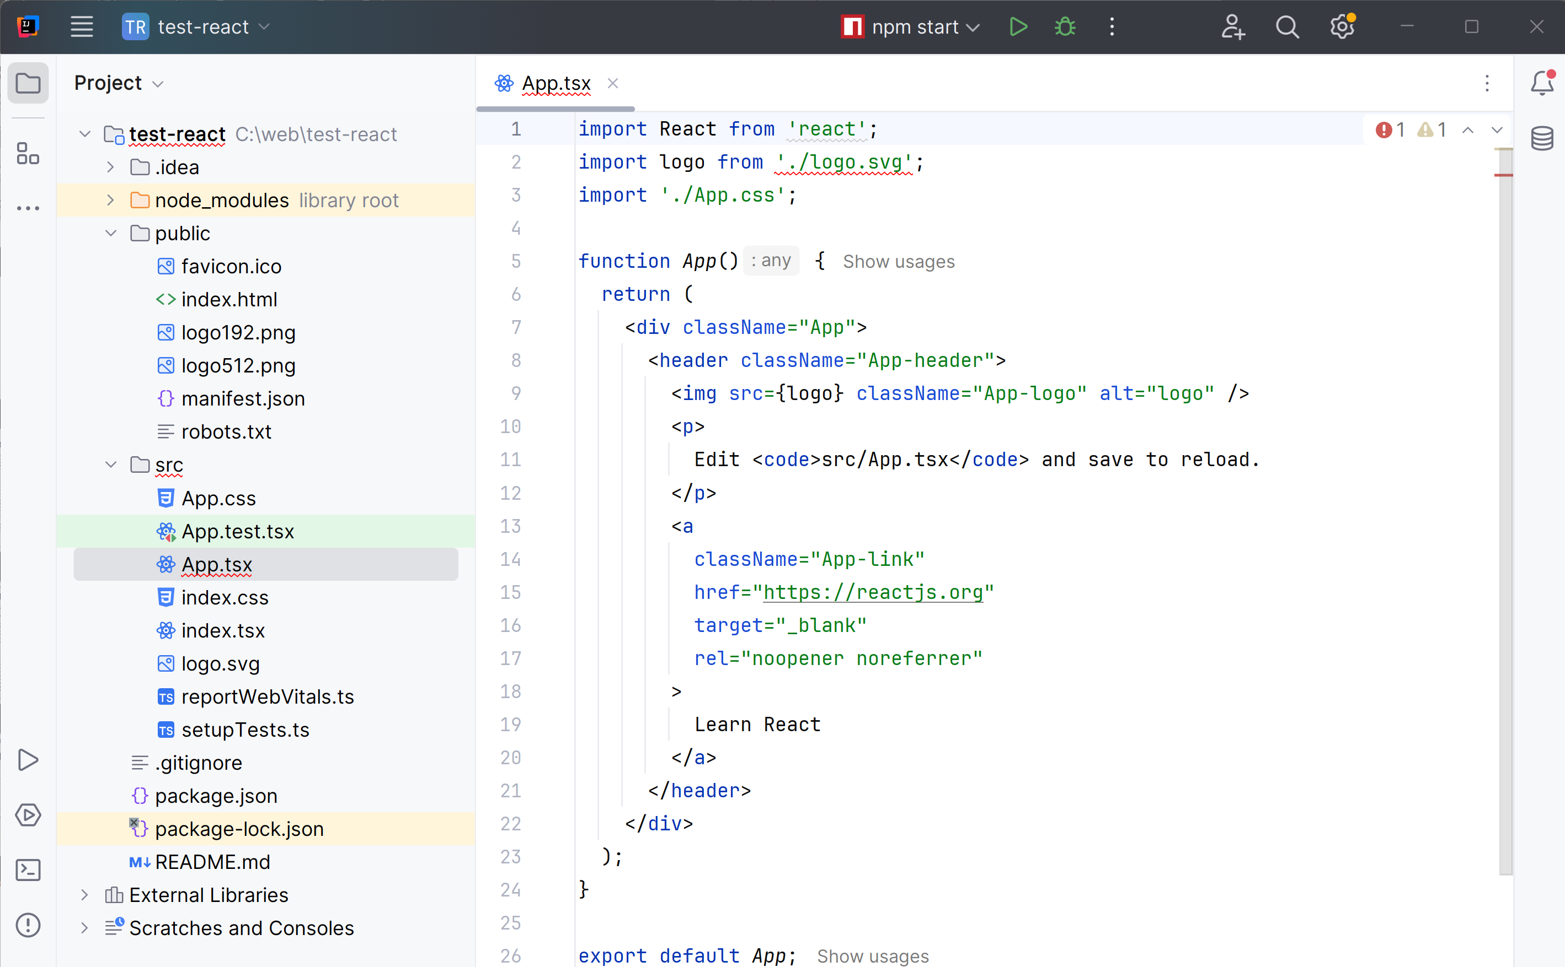
App.tsx

Slide 21
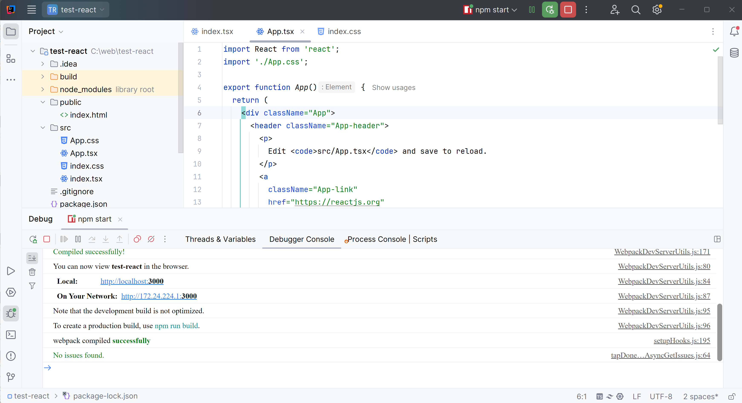
Idea Run / npm run start

Slide 22
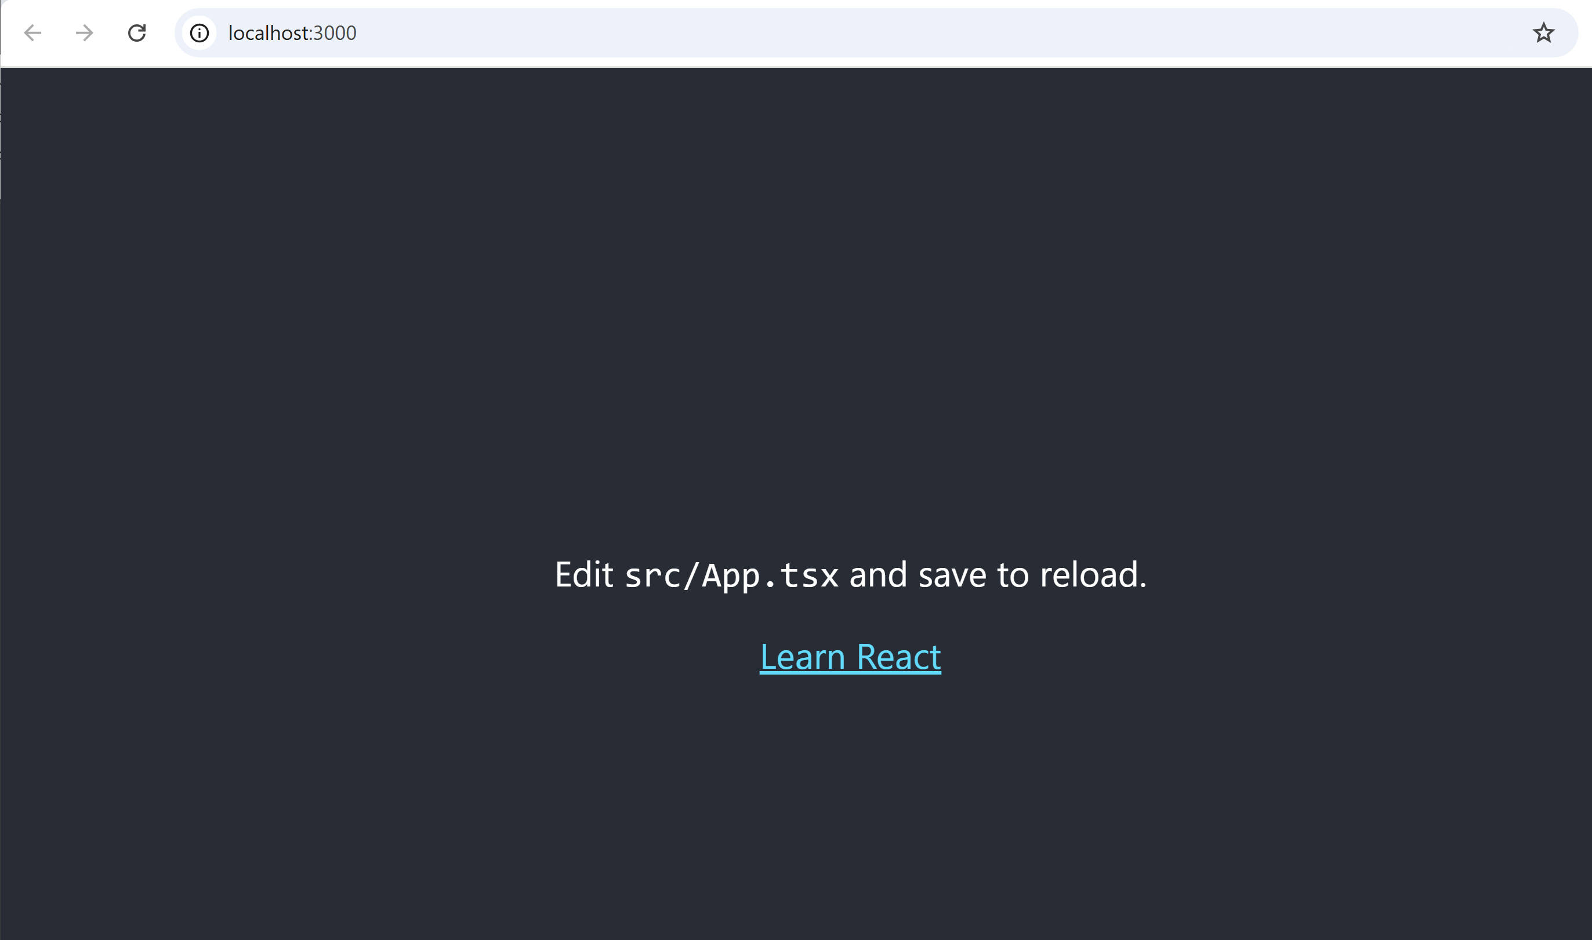
http://localhost:3000

Slide 23
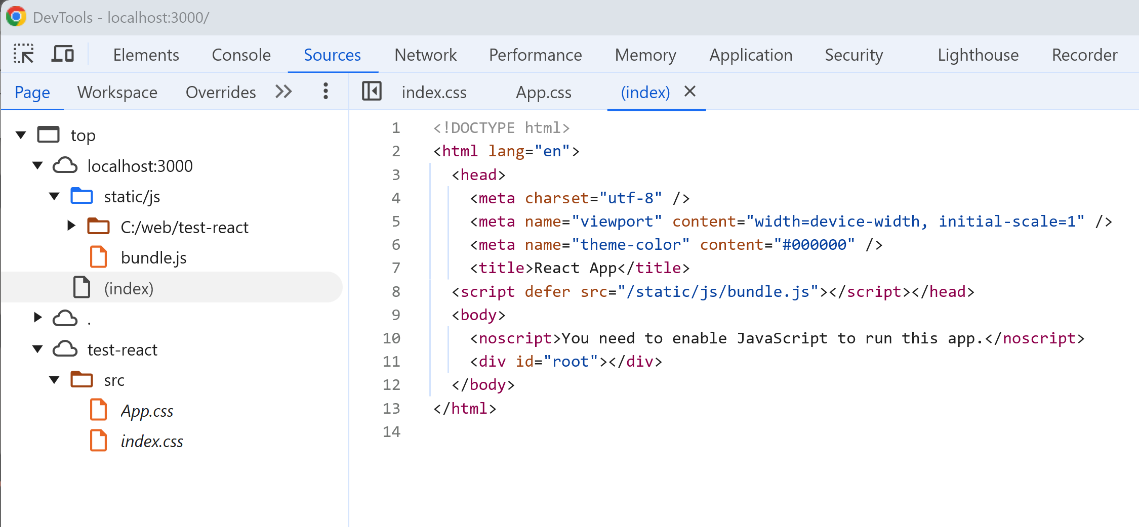
DevTools ... viewing generated "/js/bundle"

Slide 24
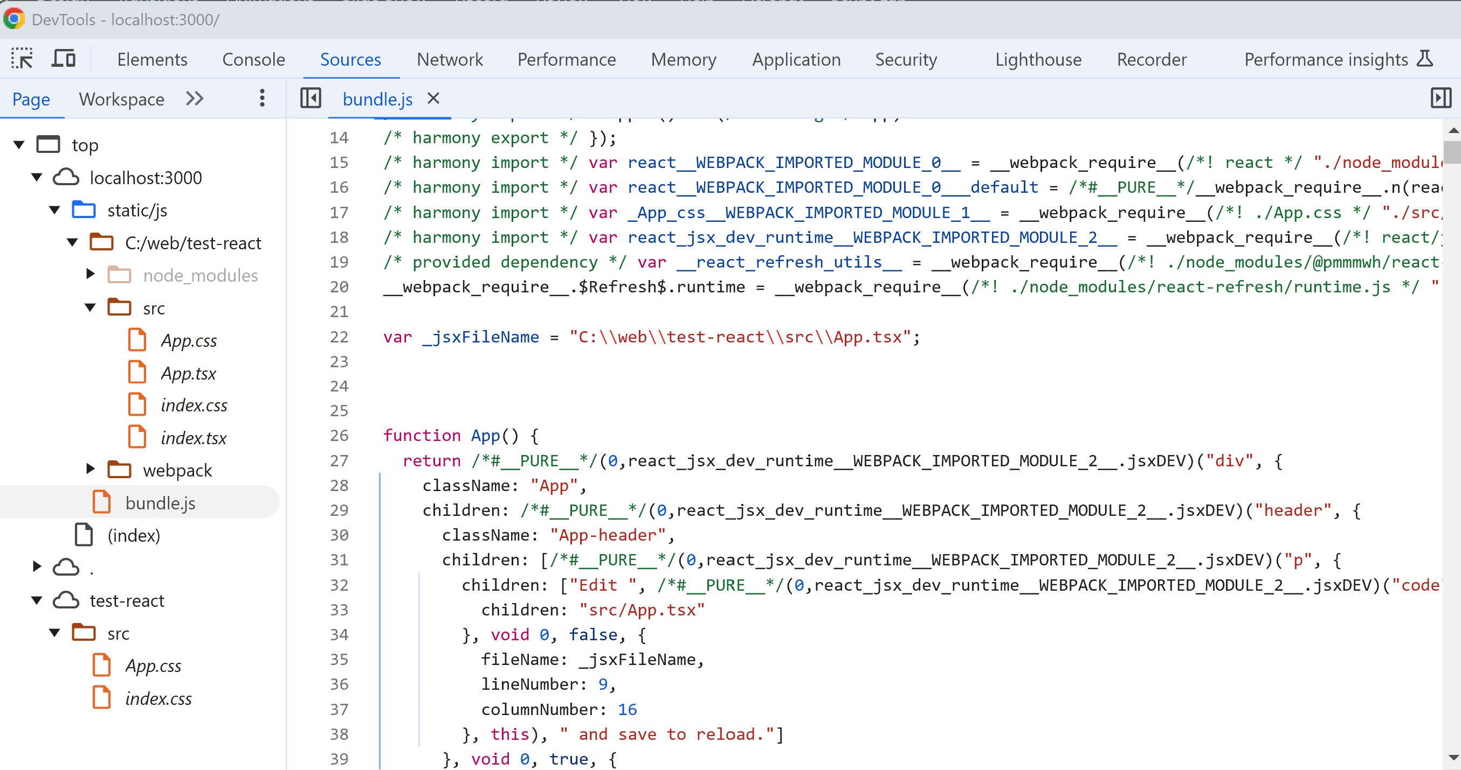
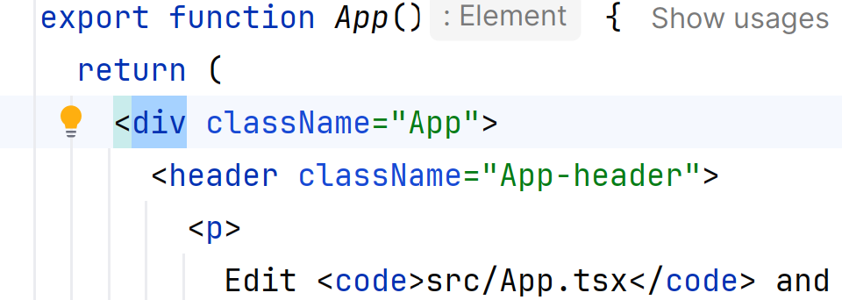
bundle ... Transpiled TSX -> to JS + react runtime on Virtual DOM

Slide 25
Exploring React Features comparison with Angular

Slide 26
Basic Features
Html Rendering template in Component
Calling a child component from a Component
templating with "If" and "For"
binding properties to a Component
binding Callback
Bi-Directional Binding ?
Routing ?
More ?

Slide 27
Basic Features Comparison with Angular
Html Rendering template in Component
Calling a child component from a Component
templating with "If" and "For"
binding properties to a Component
binding Callback
Bi-Directional Binding ?
Routing ?
More ?
{{ expression }}
expression : field in class component
<app-child />
selector="app-child" on child class
@if(..) { } @else { .. }
@for() { .. }
cf also legacy syntaxes
*ngIf="cond"
*ngFor="let i of items"
field = input();
<app-child [field]="expr">
cf also legacy syntax @Input()
onEvent = signal();
<app-child (onEvent)="cb()">
cf also legacy syntax @Output()
<app-child
[(field)] ="parentField">
...magic & simple
<a routerLink="/compA">
or router.navigate(['compA'])
form, i18n, animation, etc etc

Slide 28
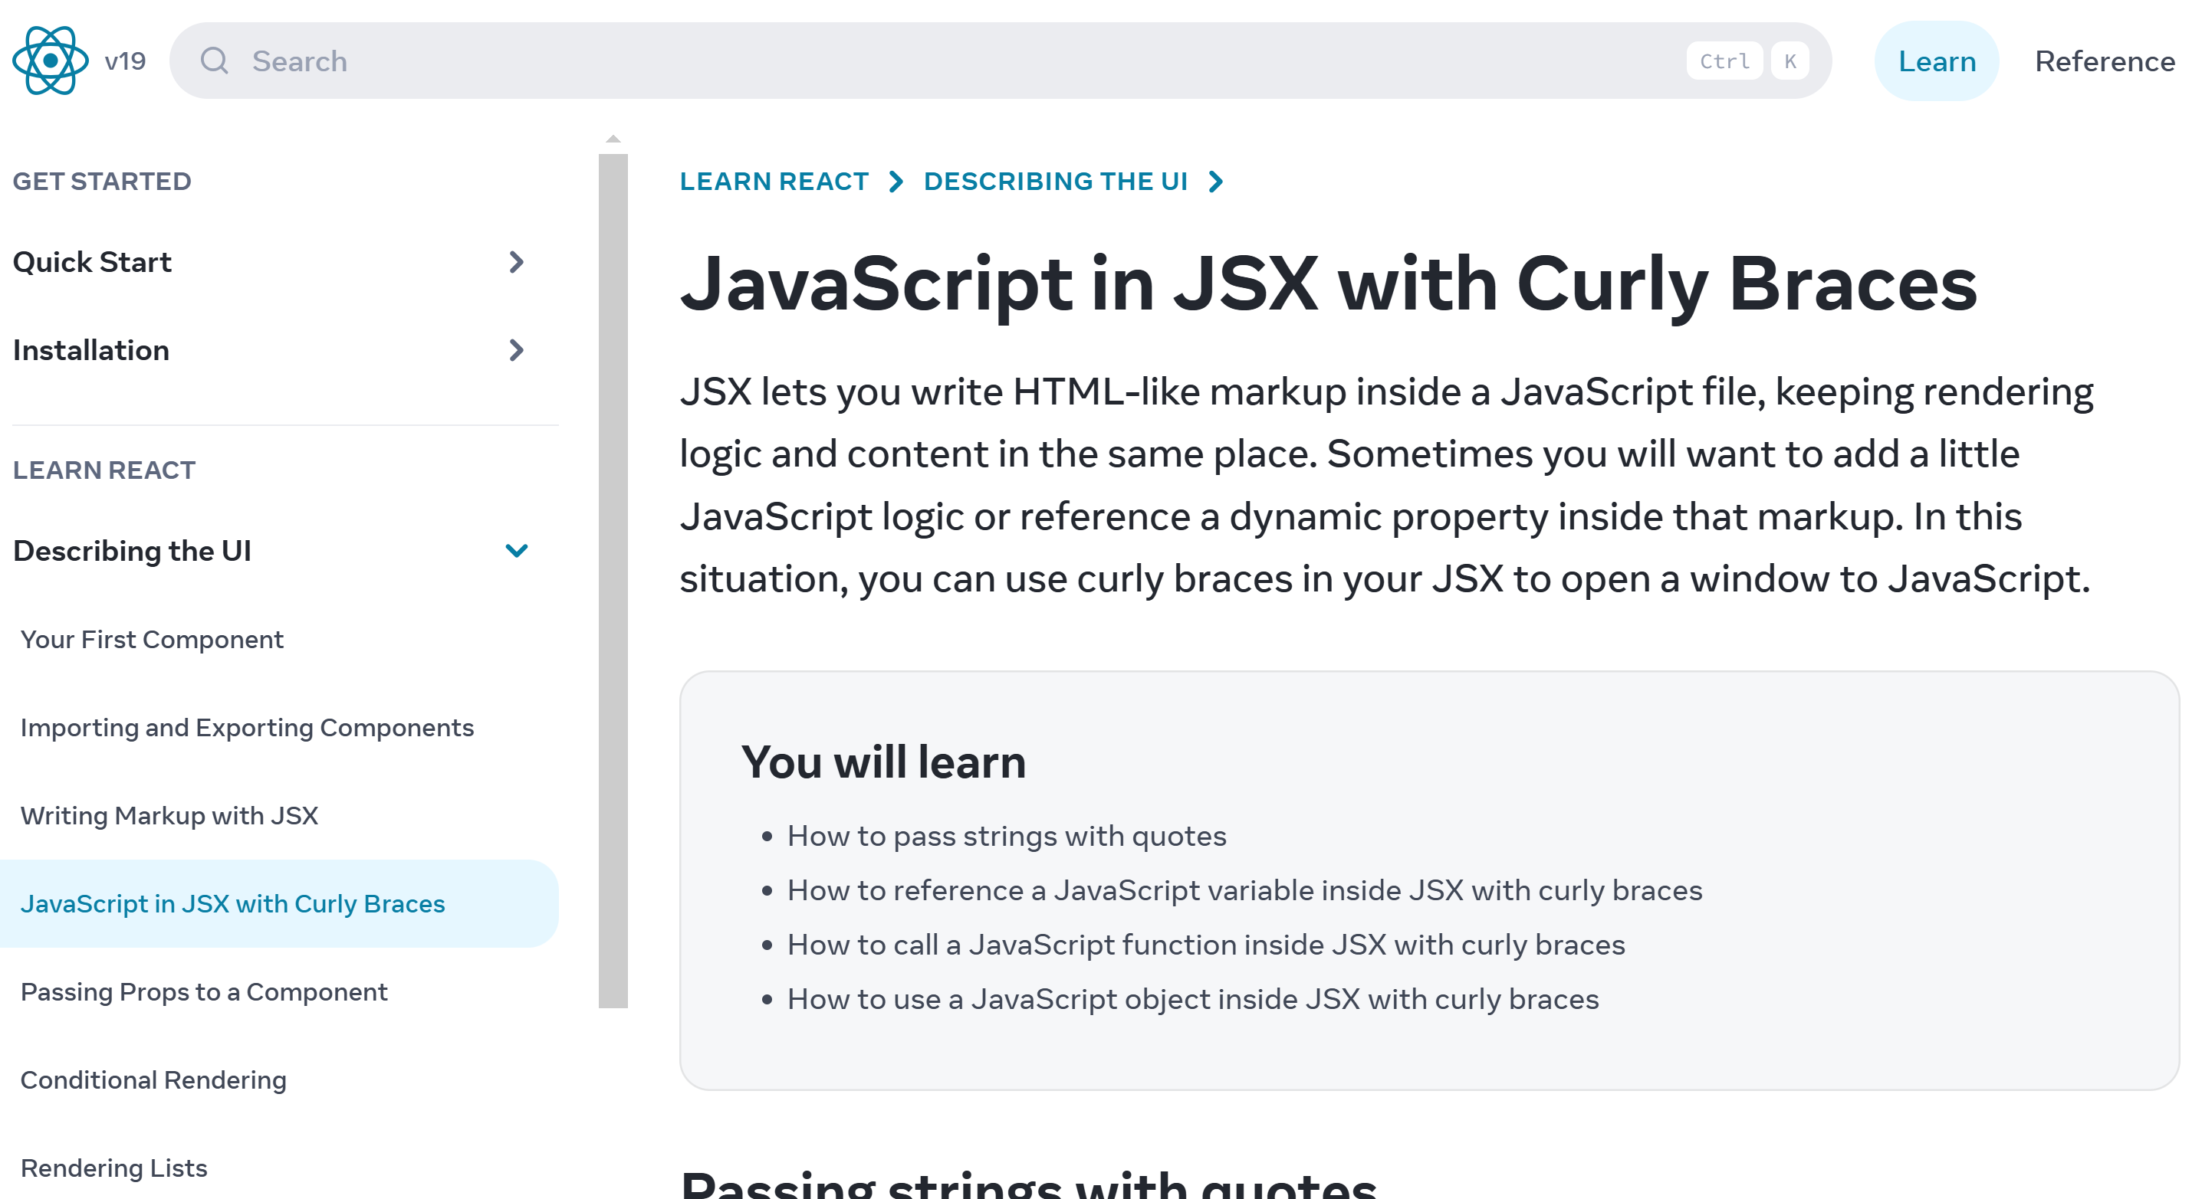
Html Rendering template in Component

Slide 29
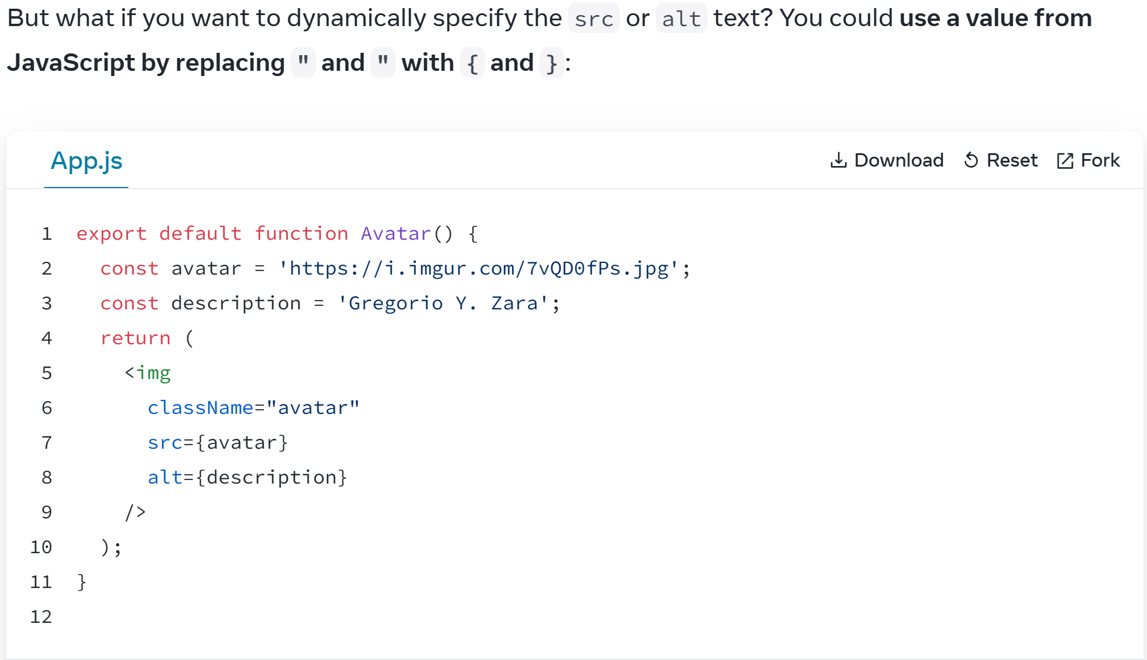
return (<App attribute={JS}> </App>);

Slide 30
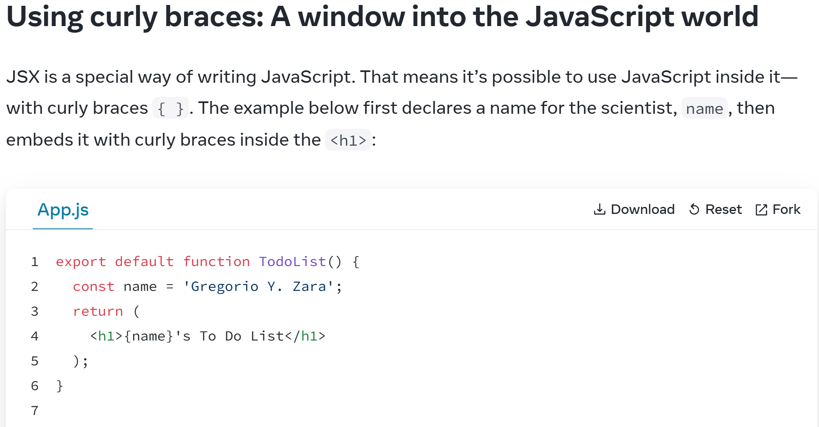
return (<App> text {JS} </App>);

Slide 31

Exploring React Features Comparison with
Html Rendering template in Component
Calling a child component from a Component
templating with "If" and "For"
binding properties to a Component
binding Callback
Bi-Directional Binding ?
Routing ?
More ?
return (<> text { expr } </>)
{{ expr }}
<app-child />
@if(..) { } @else { .. }
@for() { .. }
field = input();
<app-child [field]="expr">
onEvent = signal();
<app-child (onEvent)="cb()">
<app-child
[(field)] ="parentField">
<a routerLink="/compA">
or router.navigate(['compA'])
form, i18n, animation, etc etc

Slide 32

Class are Statefull != pure Function are stateless
@Component( ..)
export class MyComp {
stateField: string = 'Hey?';
}
function MyComp() {
return (
<>
{ stateField }
</>
);
}
<app-MyComp>
{{ stateField }}
</app-MyComp>
???????????
not a parameter
not a global variable
can not be in pure fonction

Slide 33
Class are Statefull != pure Function are stateless BUT React use "Hook" useState() !!
@Component( ..)
export class MyComp {
stateField: string = 'Hey?';
}
import { useState } from 'react';
function MyComp () {
const [ stateField, setStateField ] = useState<string>('Hey?)
return (
<>
{ stateField }
</>
);
}
<app-MyComp>
{{ stateField }}
</app-MyComp>

Slide 34
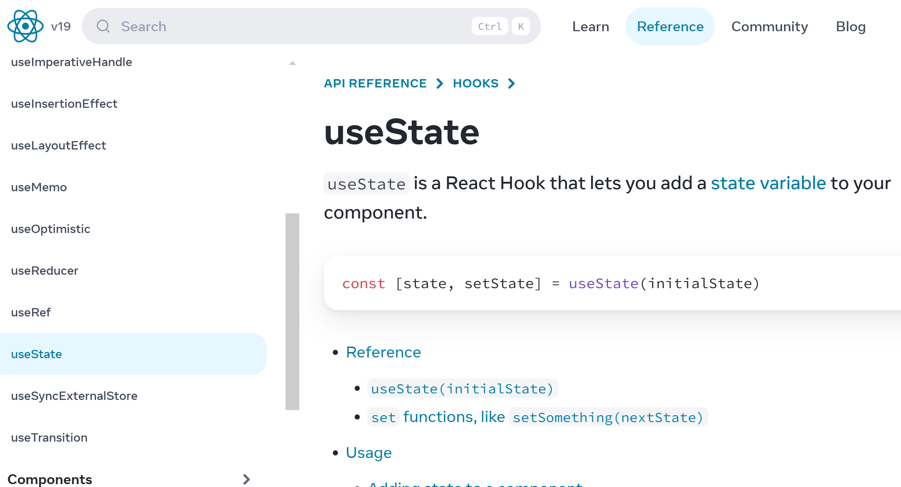
useState is a React Hook for state variable

Slide 35
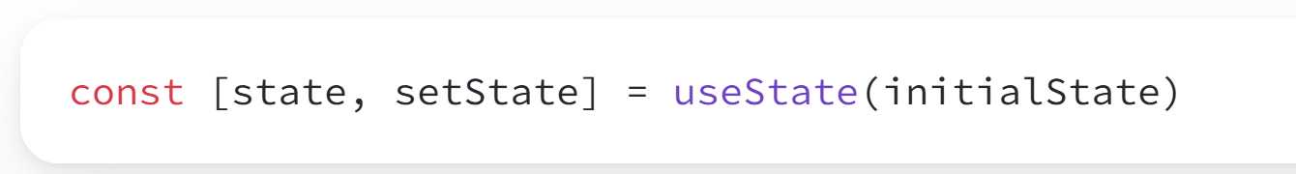
Notice ... state "Variable" is "const" !! but there is a setter
In TypeScript, this is equivalent of declaring 2 constants
const state: Type = initialState;
const setState: (value: Type) => void = function(value) { magic update that trigger re-rendering ... }
This does not compile "state = newValue", but ok with "setState(newValue)"

Slide 36
Setter then Automatically re-rendering
In angular, you just do
this.state = newValue;
=> it automatically re-renders
May use explicit "PushMode" for performance
May also use angular 17 "signal()" and "computed()"
In React, you just do
setState(newValue);
=> it automatically re-renders
May also use "effect( () => { ... } )"
to do outside of method call

Slide 37
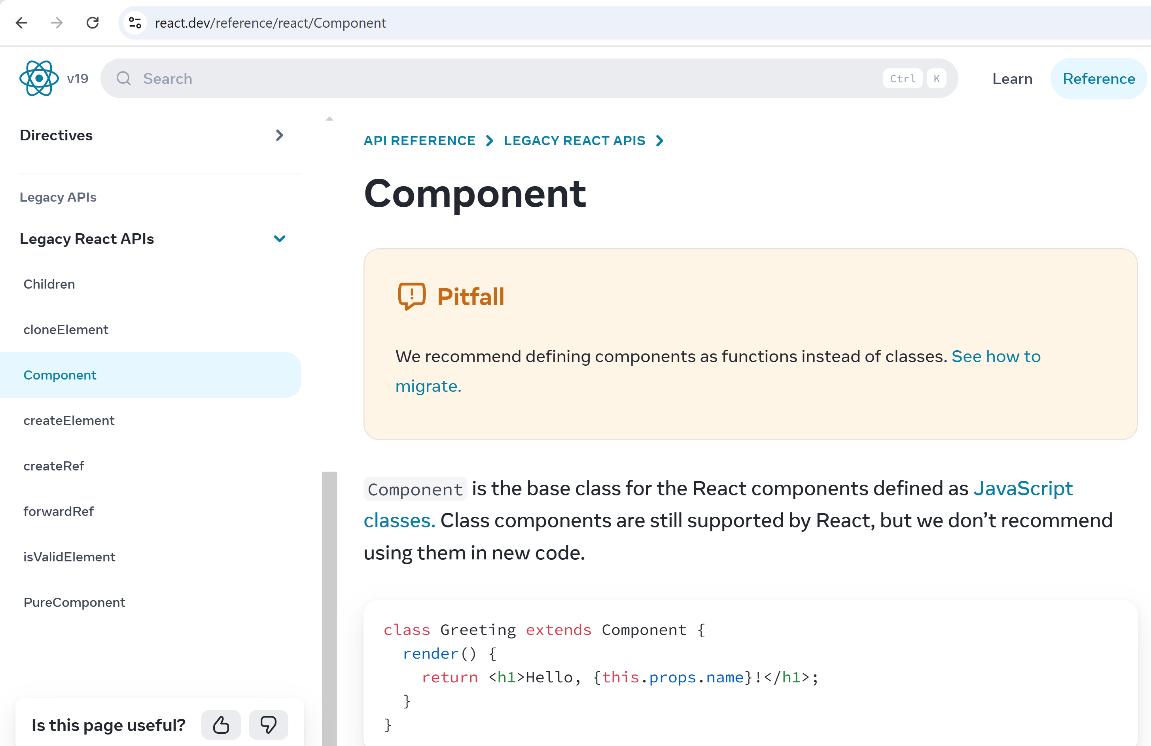
Why React Functions ? it used to be "Class" (now legacy)

Slide 38
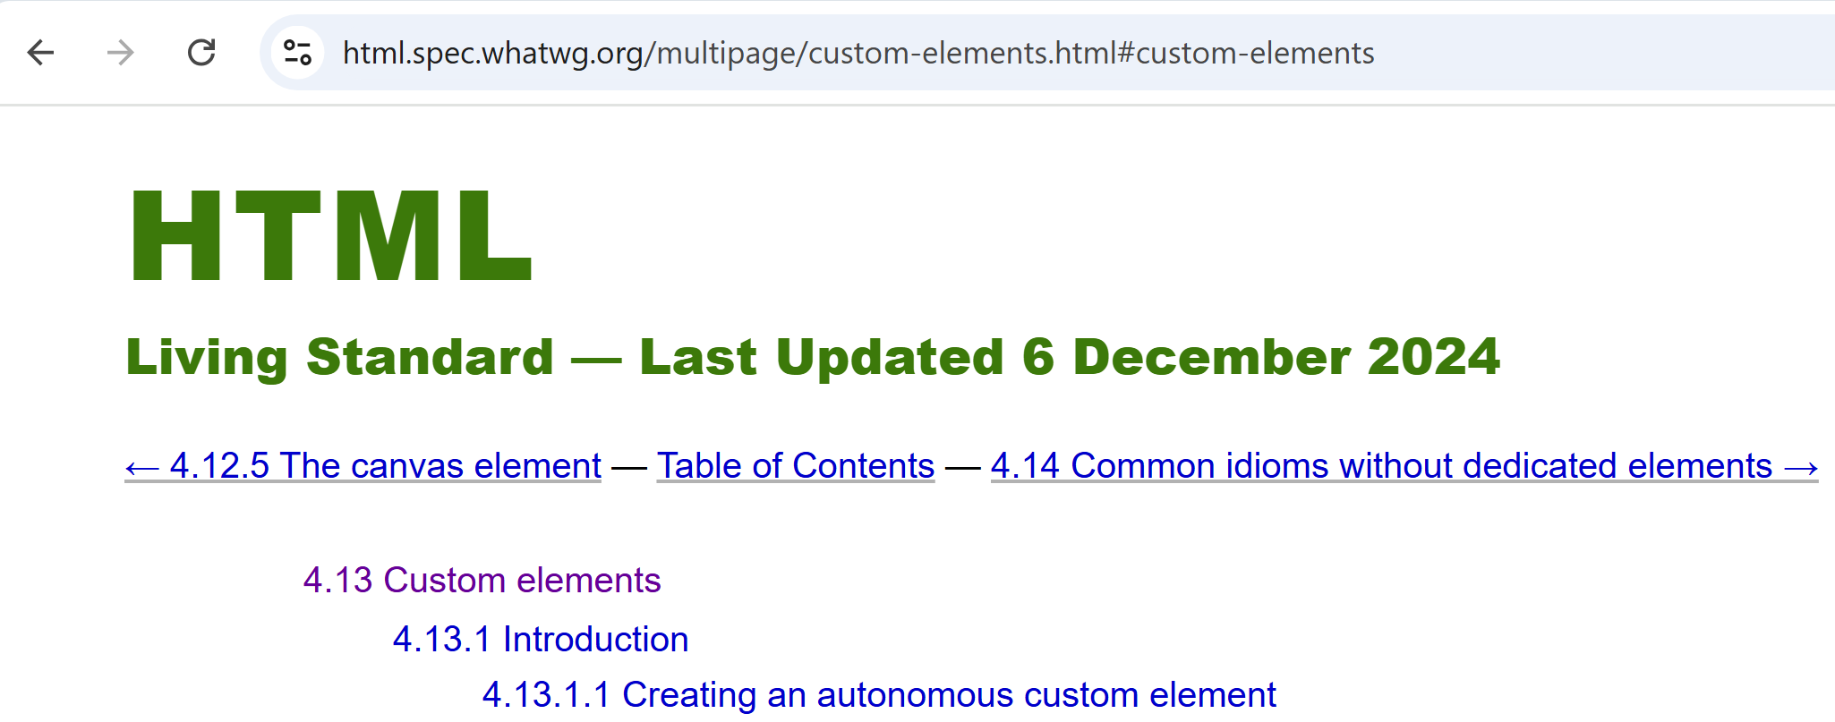
React moving away from W3C Standard Spec " CustomElement are classes"

Slide 39
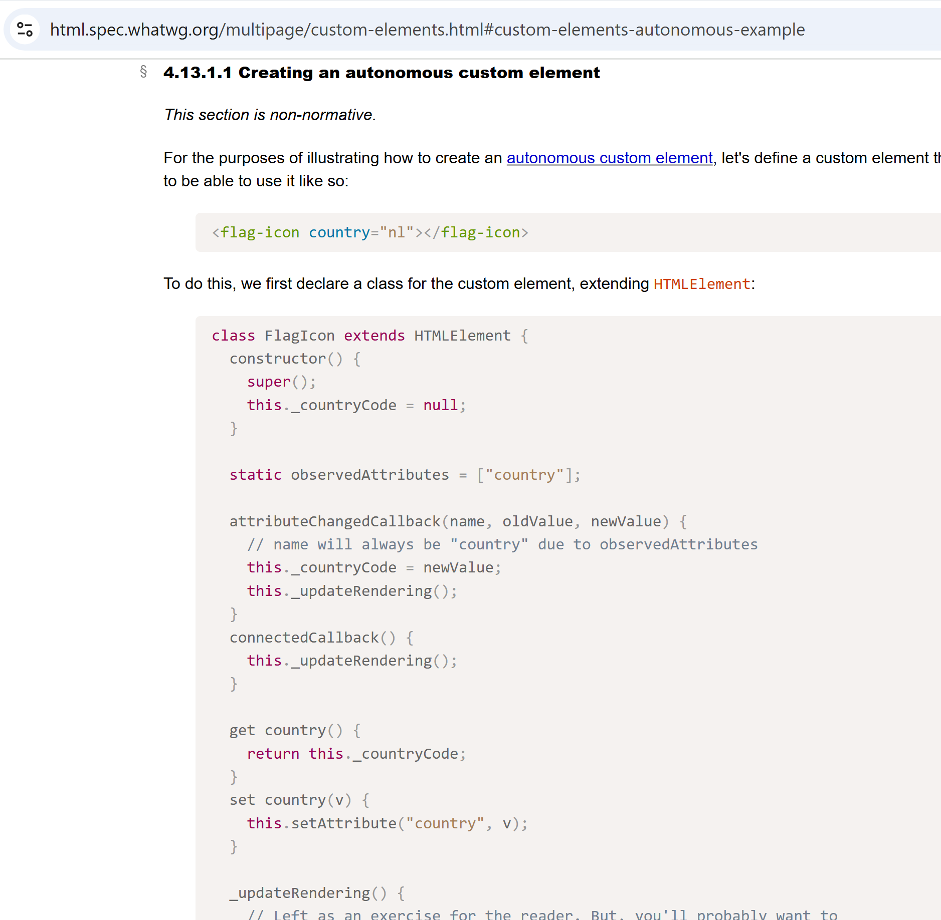
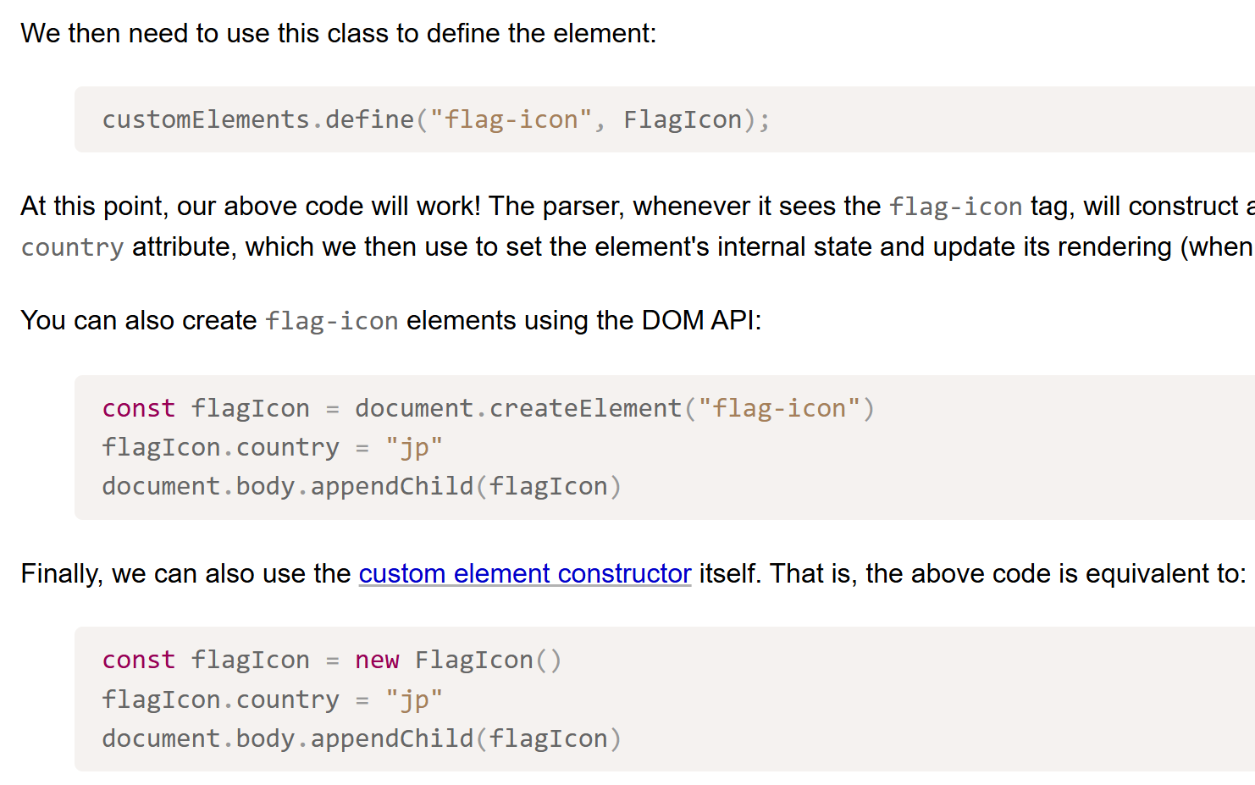
CustomElement = class + register it
class
lifecycle
methods
attr,
getter,
setter

Slide 40
Exploring React Features Comparison with
const [x, setX] = useState()
return (<> text { expr } </>)
{{ expr }}
Html Rendering template in Component
Calling a child component from a Component
templating with "If" and "For"
binding properties to a Component
binding Callback
Bi-Directional Binding ?
Routing ?
More ?
<app-child />
@if(..) { } @else { .. }
@for() { .. }
field = input();
<app-child [field]="expr">
onEvent = signal();
<app-child (onEvent)="cb()">
<app-child
[(field)] ="parentField">
<a routerLink="/compA">
or router.navigate(['compA'])
form, i18n, animation, etc etc

Slide 41
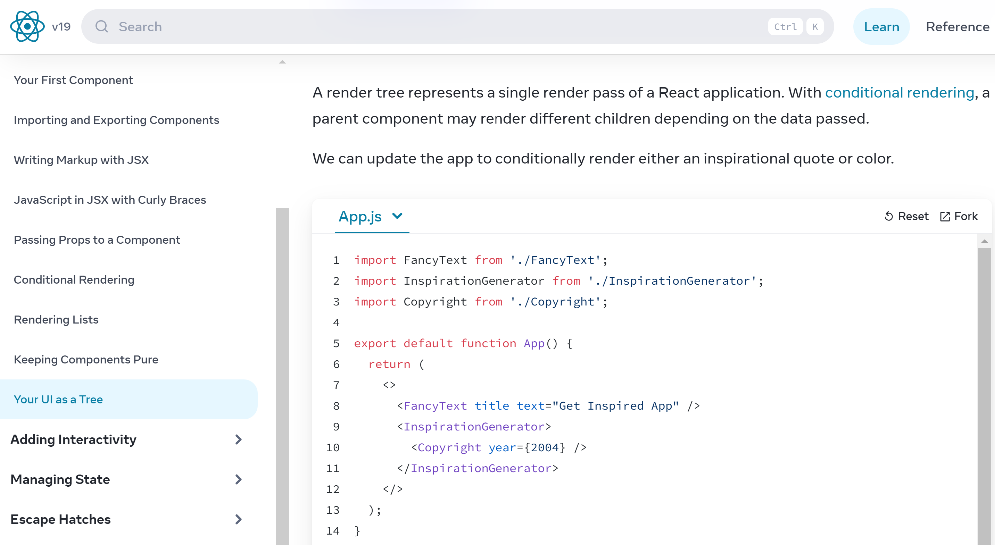
Calling a child component from a Component

Slide 42
Exploring React Features Comparison with
const [x, setX] = useState()
return (<> text { expr } </>)
{{ expr }}
Html Rendering template in Component
Calling a child component from a Component
templating with "If" and "For"
binding properties to a Component
binding Callback
Bi-Directional Binding ?
Routing ?
More ?
return (<> <AppChild /> </>)
<app-child />
@if(..) { } @else { .. }
@for() { .. }
field = input();
<app-child [field]="expr">
onEvent = signal();
<app-child (onEvent)="cb()">
<app-child
[(field)] ="parentField">
<a routerLink="/compA">
or router.navigate(['compA'])
form, i18n, animation, etc etc

Slide 43
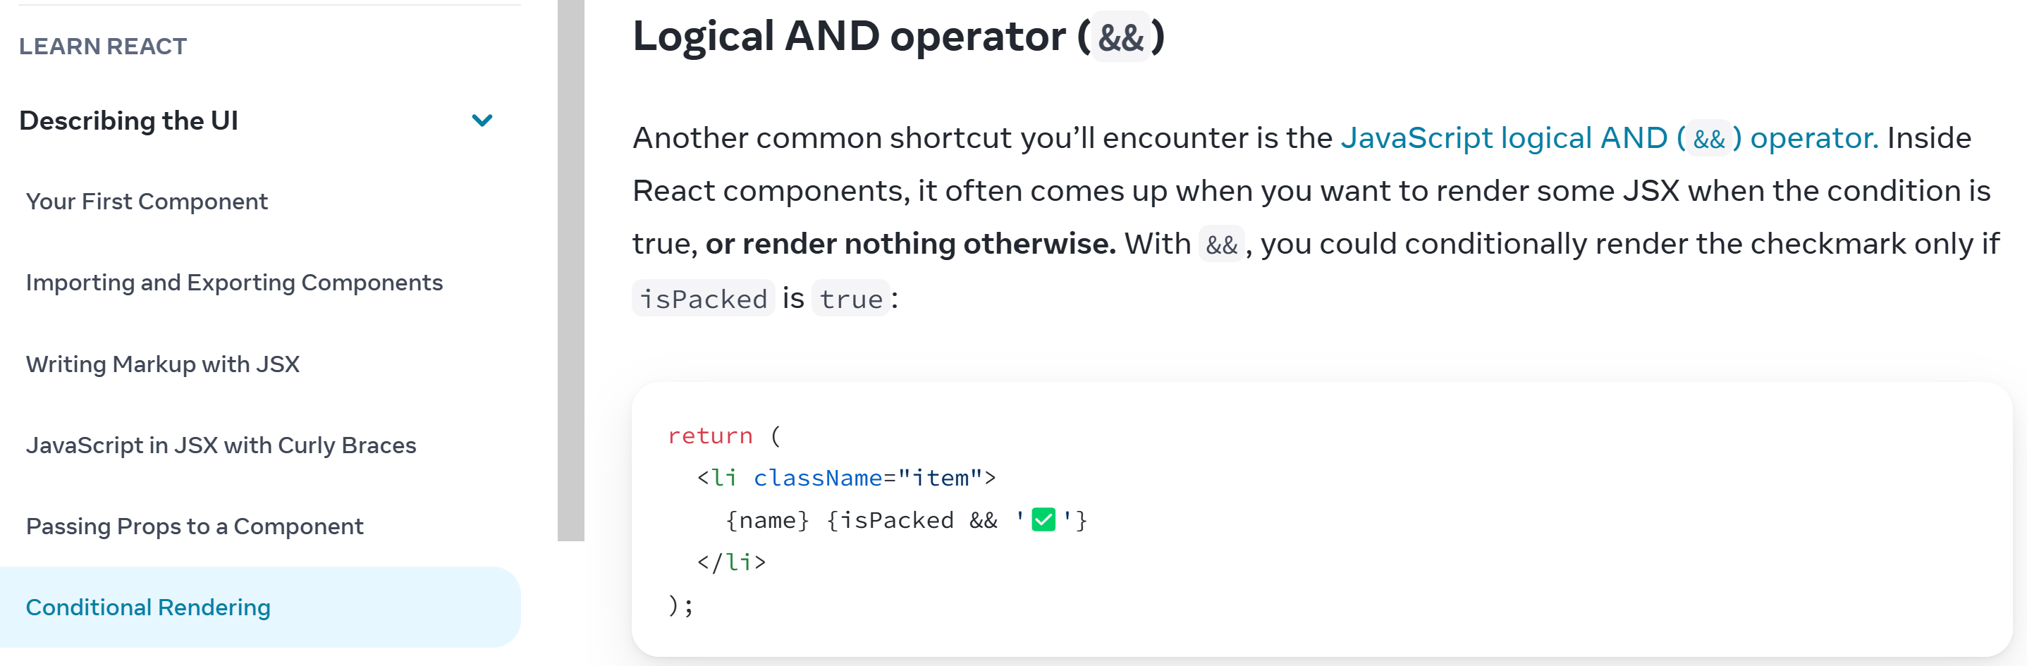
Equivalent of NG @if() { cond && <Elt/> }

Slide 44
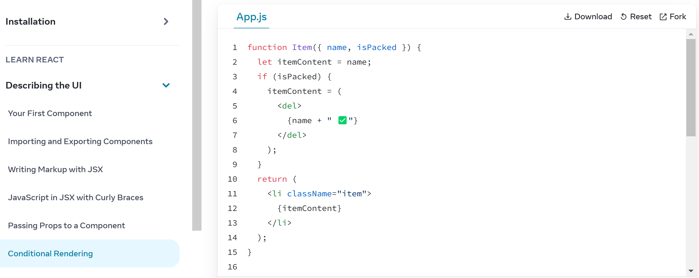
plain old "If()", and local variable with <HTML>

Slide 45
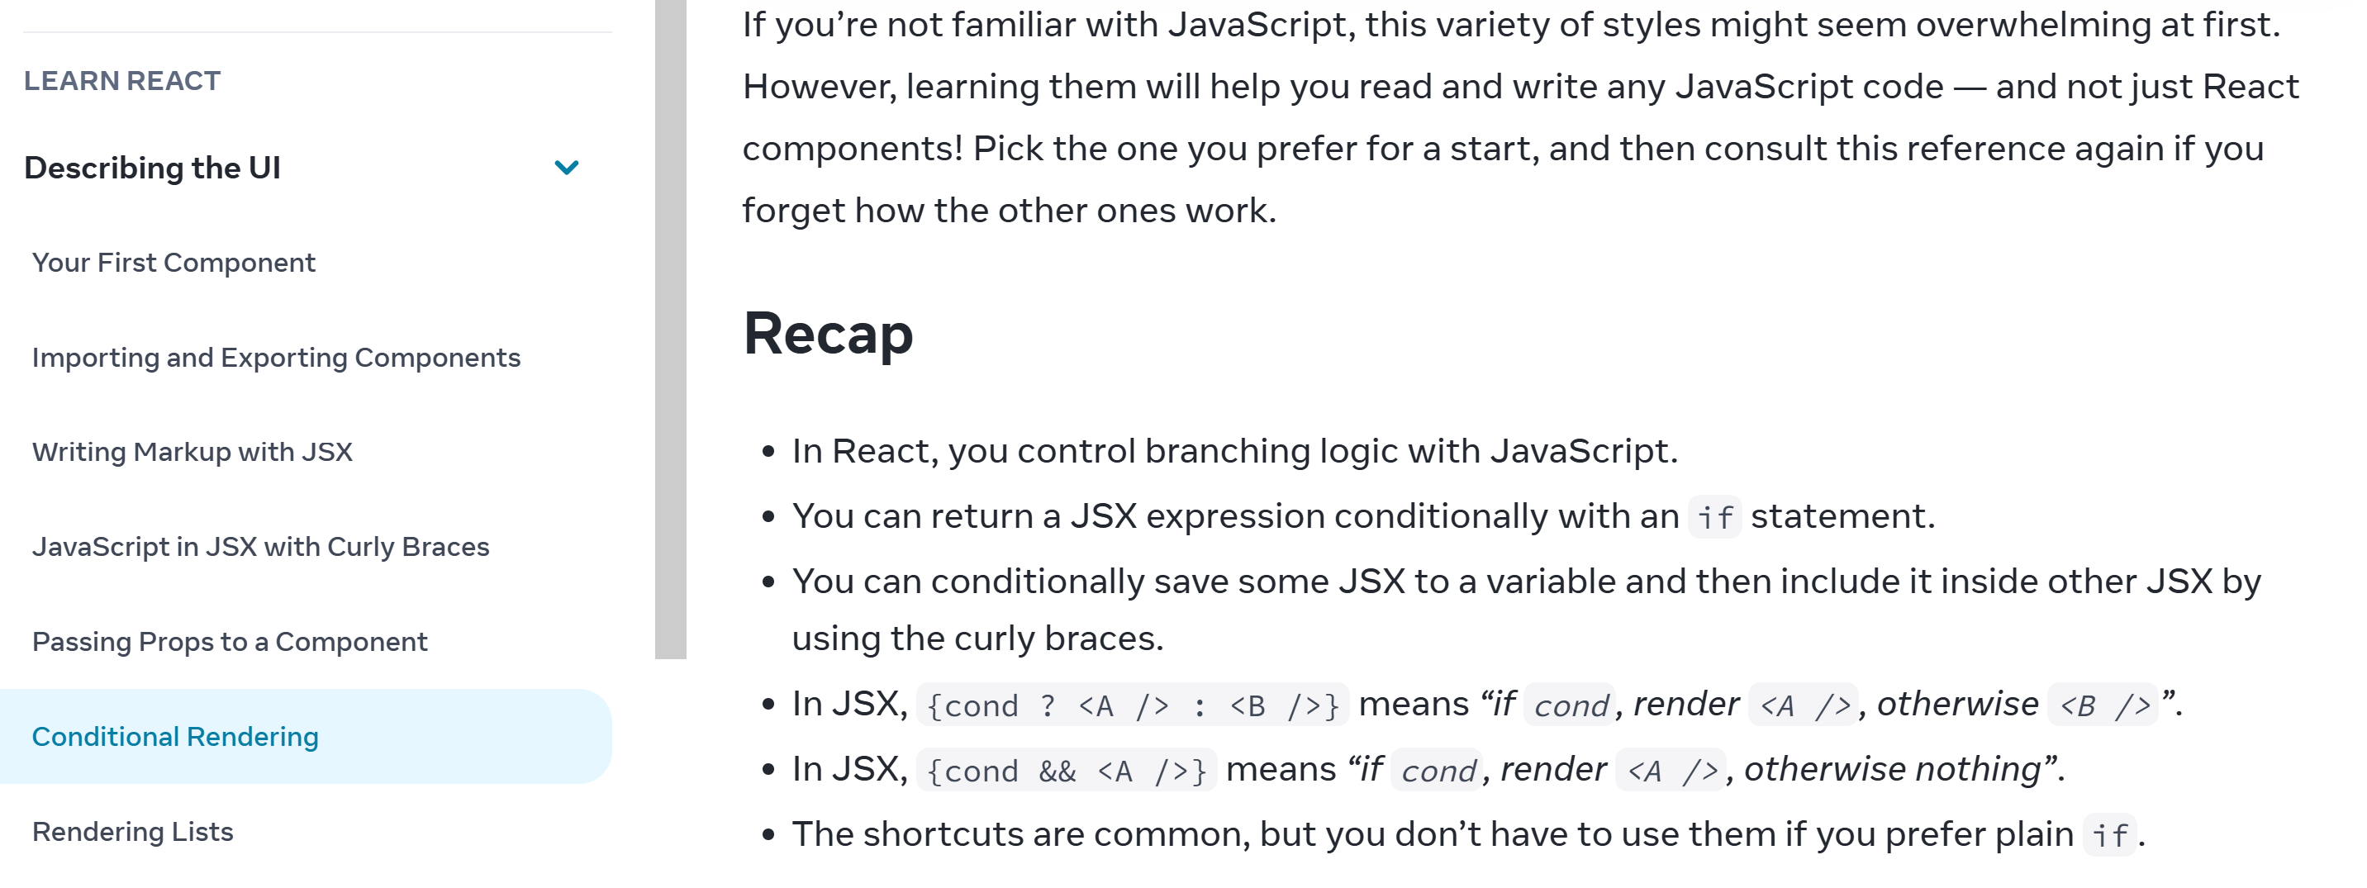
equivalent of NG @if() { } @else { }

Slide 46
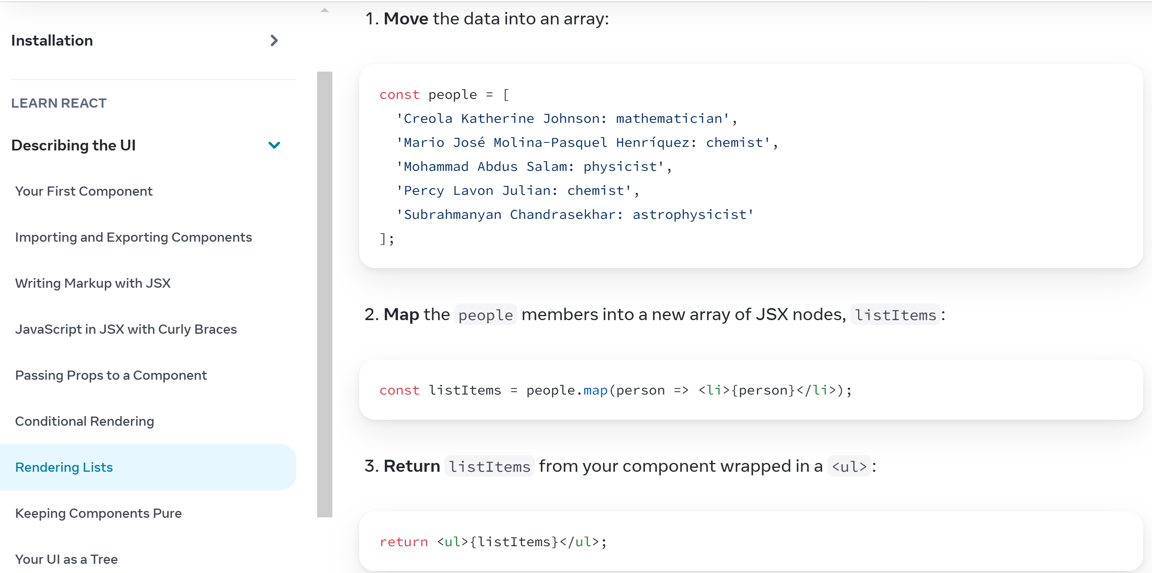
Equivalent of NG @for() using JS .map(x => (<> {x} </>) ) function!

Slide 47
Exploring React Features Comparison with
const [x, setX] = useState()
return (<> text { expr } </>)
Html Rendering template in Component
Calling a child component from a Component
templating with "If" and "For"
binding properties to a Component
binding Callback
Bi-Directional Binding ?
Routing ?
More ?
{{ expr }}
return (<> <AppChild /> </>)
<app-child />
{cond && (<> </>) }
@if(..) { } @else { .. }
@for() { .. }
{items.map(i => (<> {i} </>) ) }
field = input();
<app-child [field]="expr">
onEvent = signal();
<app-child (onEvent)="cb()">
<app-child
[(field)] ="parentField">
<a routerLink="/compA">
or router.navigate(['compA'])
form, i18n, animation, etc etc

Slide 48
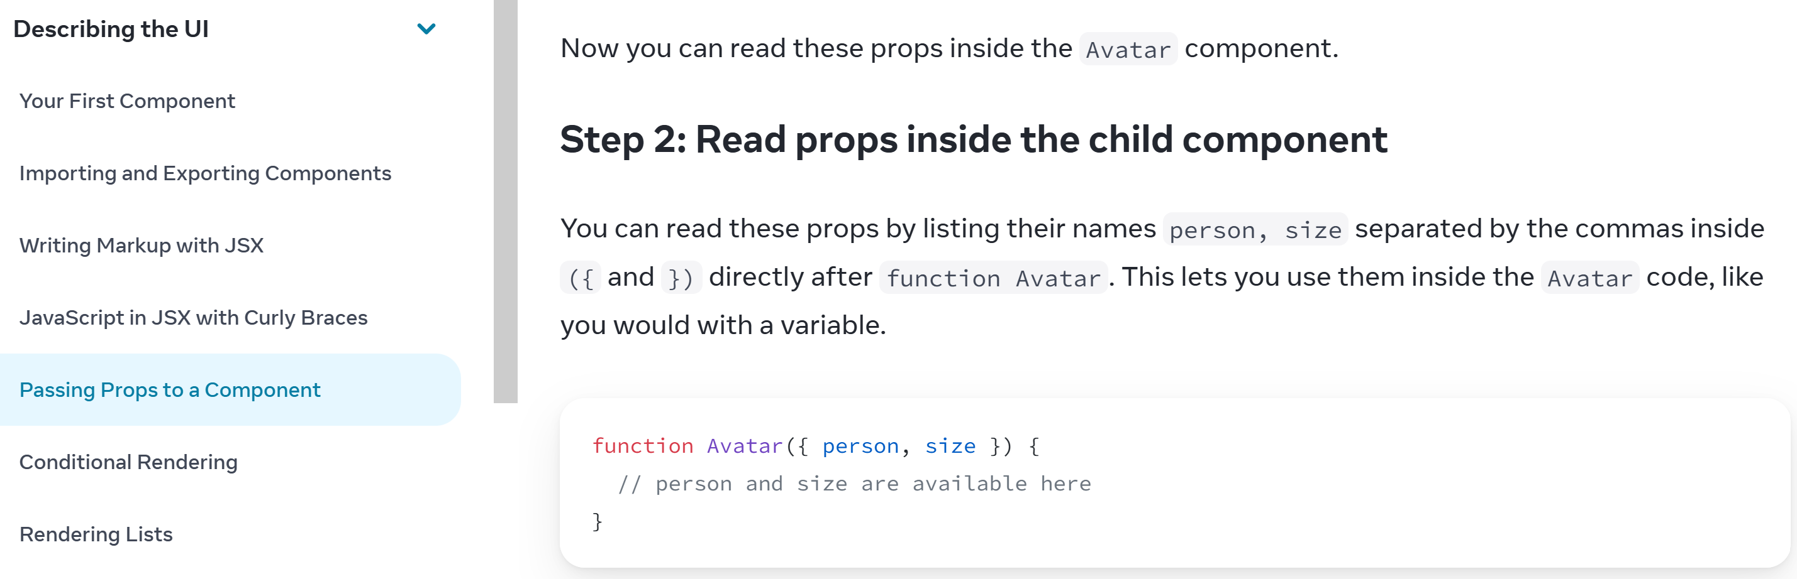
Passing Properties equivalent to NG input() or "@Input"

Slide 49
Reminder... TypeScript Object Parameter De-Structuring
In Typescript (nothing specific to React)
is equivalent to ..
... NOTICE: props can contains others members
myFunc ( { a: number, b: string, ...others } ) { a ... }
interface TProps {
a: number;
b: string;
}
myFunc ( props : TProps ) { props.a ... }

Slide 50
Exploring React Features Comparison with
const [x, setX] = useState()
return (<> text { expr } </>)
Html Rendering template in Component
Calling a child component from a Component
templating with "If" and "For"
binding properties to a Component
binding Callback
Bi-Directional Binding ?
Routing ?
More ?
{{ expr }}
return (<> <AppChild /> </>)
<app-child />
{cond && (<> </>) }
@if(..) { } @else { .. }
@for() { .. }
{items.map(i => (<> {i} </>) ) }
function AppChild({ field }) {..}
<AppChild field={expr} />
field = input();
<app-child [field]="expr">
onEvent = signal();
<app-child (onEvent)="cb()">
<app-child
[(field)] ="parentField" />
<a routerLink="/compA">
or router.navigate(['compA'])
form, i18n, animation, etc etc

Slide 51
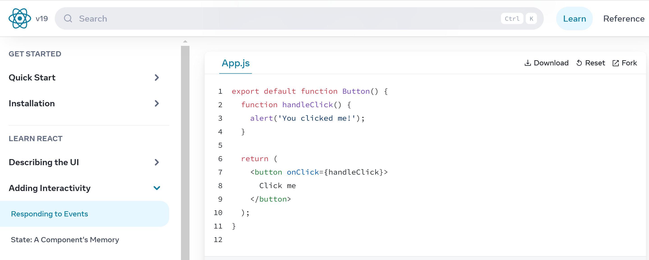
Responding to Event

Slide 52
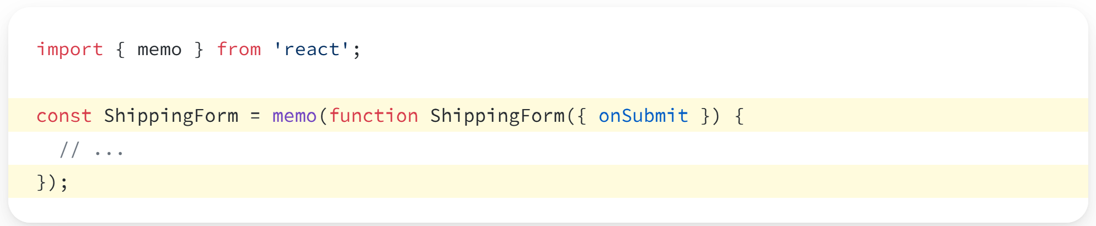
binding callback Outside of Component .. same as properties: pass function callback

Slide 53
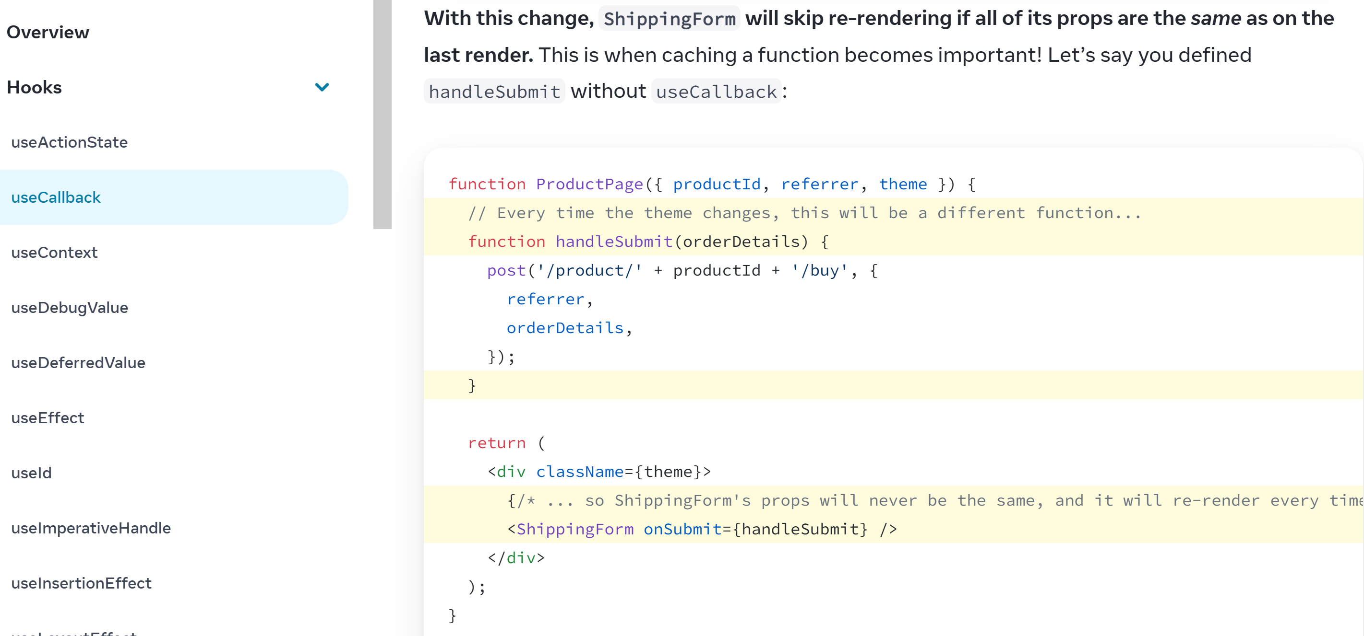
!! Re-Rendering Performance !!

Slide 54
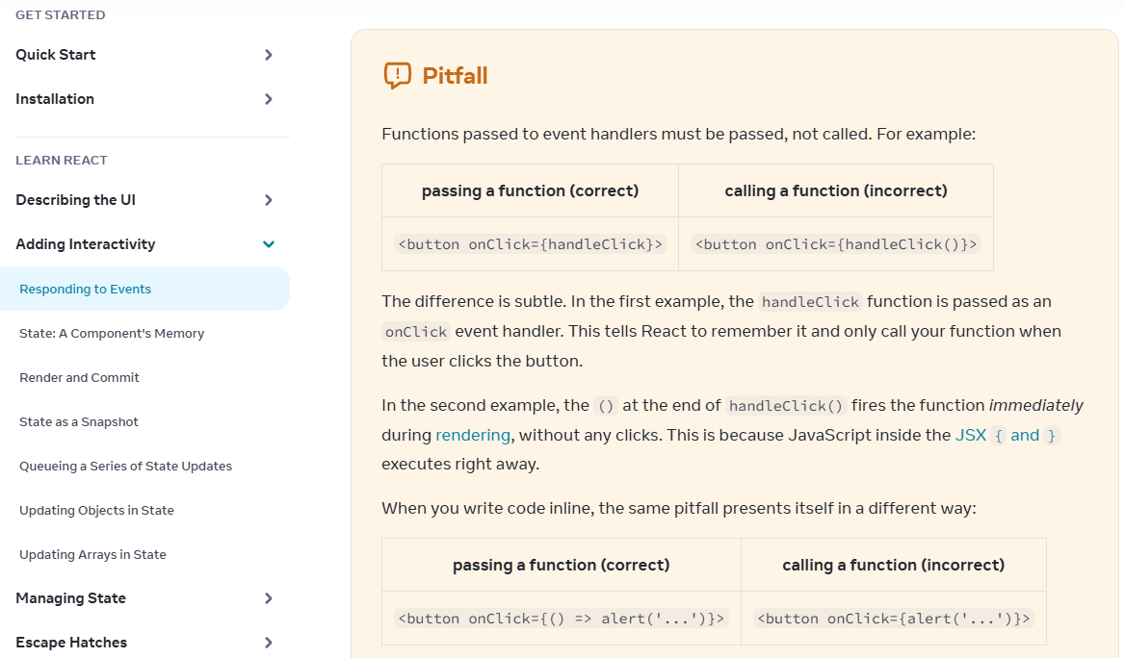
pass Function pointer, or recreate: function() { ..} or () => { ..}

Slide 55
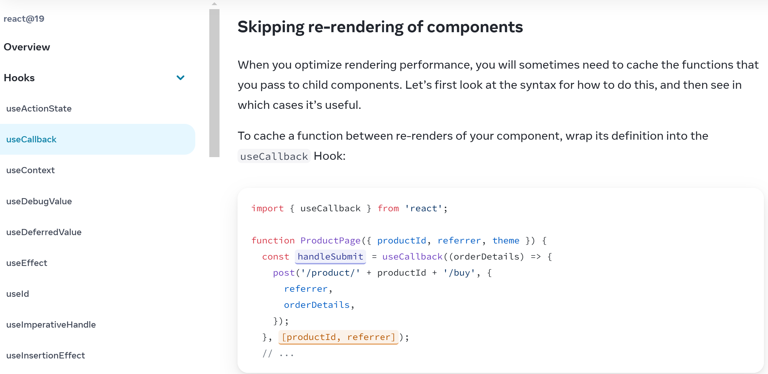
binding callback Outside of Component wrap with Hook "useCallback(() => ...)"

Slide 56
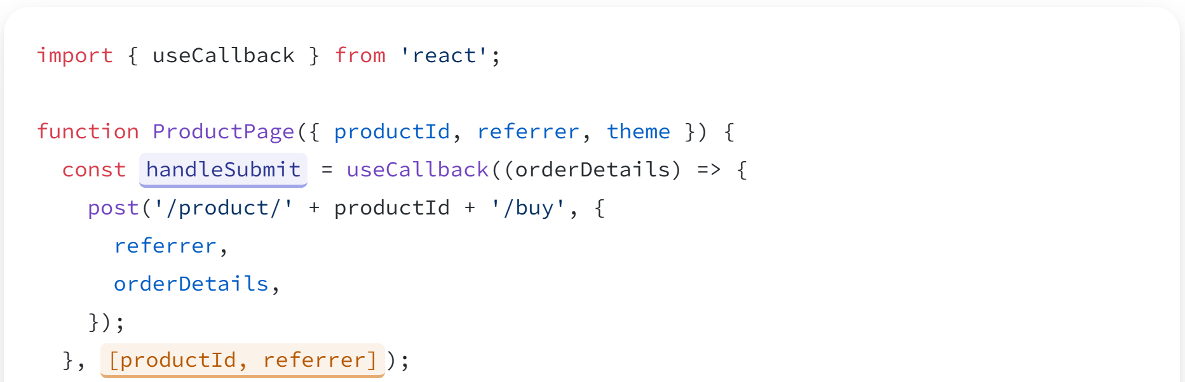
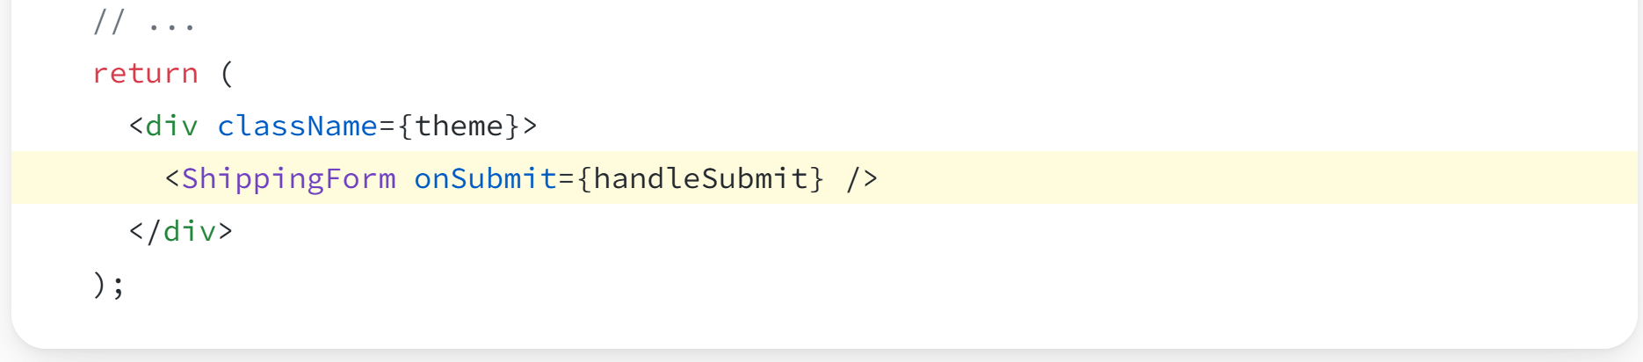
<App onXX={useCallback((x) => f(x,y), [y])} >

Slide 57
Exploring React Features Comparison with
const [x, setX] = useState()
return (<> text { expr } </>)
{{ expr }}
Html Rendering template in Component
Calling a child component from a Component
templating with "If" and "For"
binding properties to a Component
binding Callback
Bi-Directional Binding ?
Routing ?
More ?
return (<> <AppChild /> </>)
<app-child />
{cond && (<> </>) }
@if(..) { } @else { .. }
@for() { .. }
{items.map(i => (<> {i} </>) ) }
function AppChild({ field }) {..}
<AppChild field={expr} />
field = input();
<app-child [field]="expr">
<AppChild onX="{ () => f() }"
on={useCallback((x)=>f(x,y), [y])}>
onEvent = signal();
<app-child (onEvent)="cb()">
<app-child
[(field)] ="parentField">
<a routerLink="/compA">
or router.navigate(['compA'])
form, i18n, animation, etc etc

Slide 58
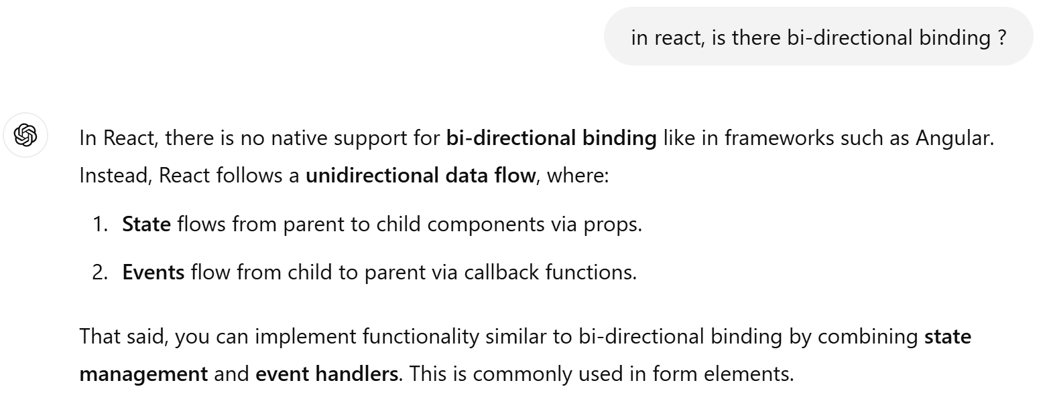
NO Bi-Directional Binding in React !!??

Slide 59
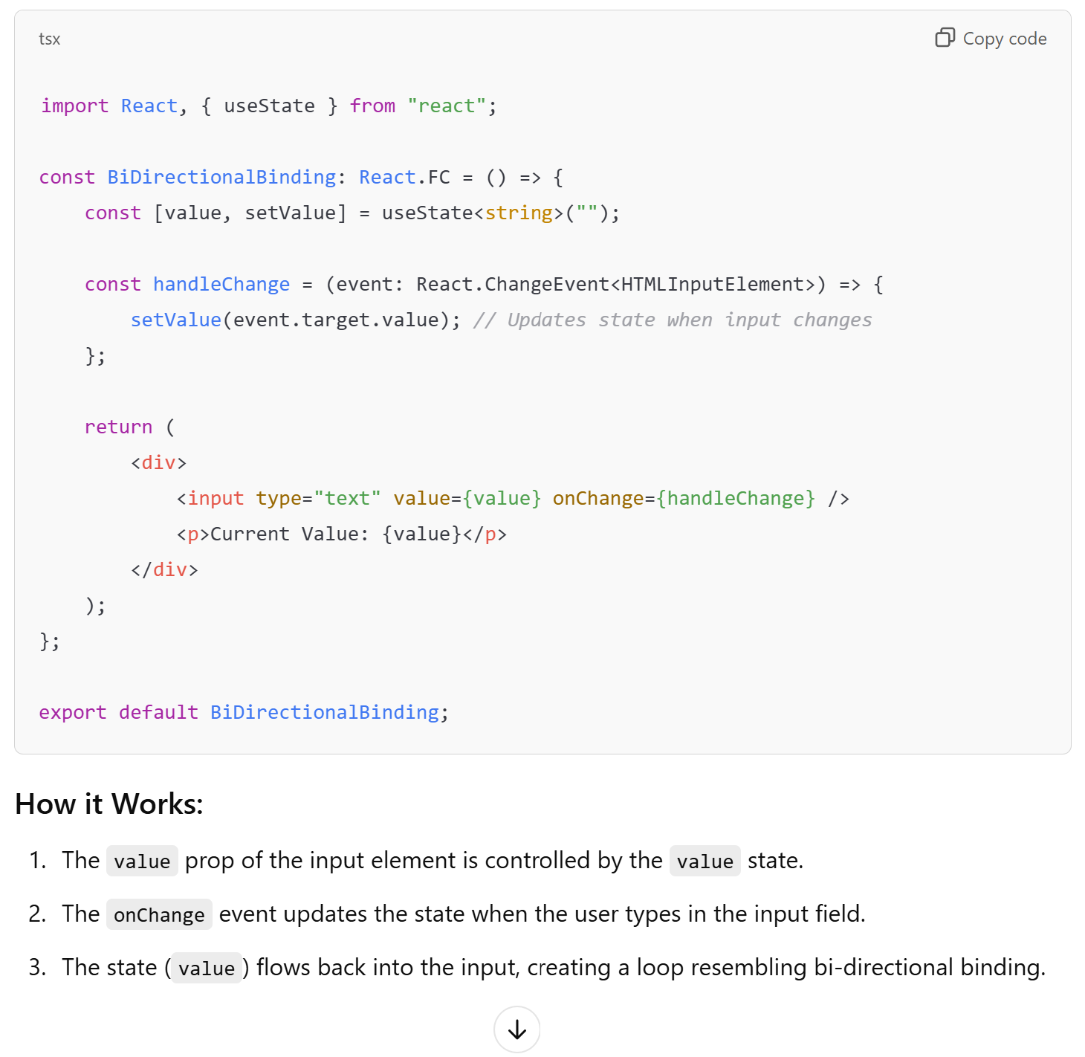
useState + explicit {render} + callback setter
value = '';
<input type="text" [(ngModel)]="value">

Slide 60
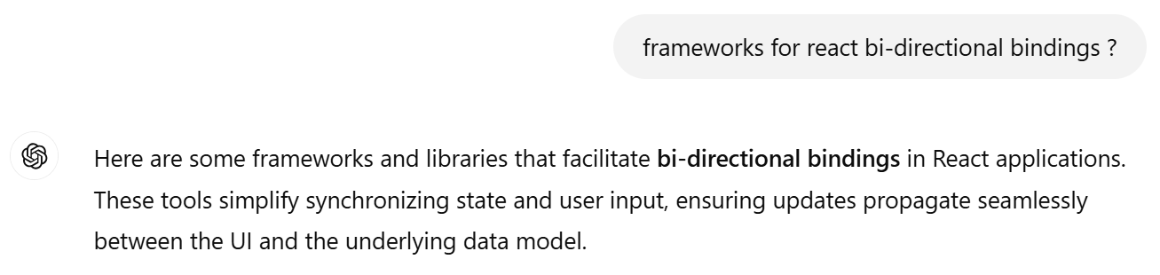
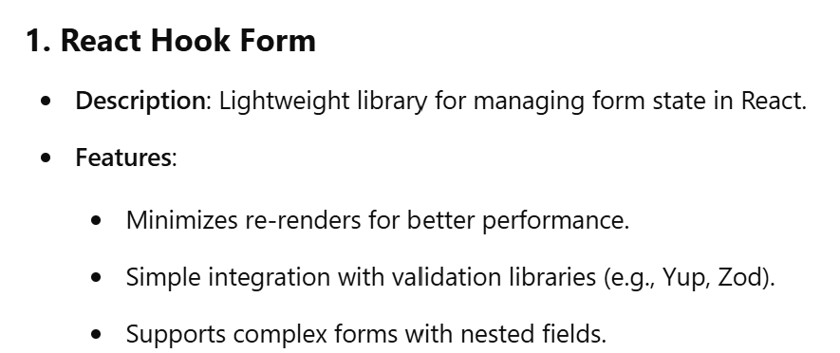
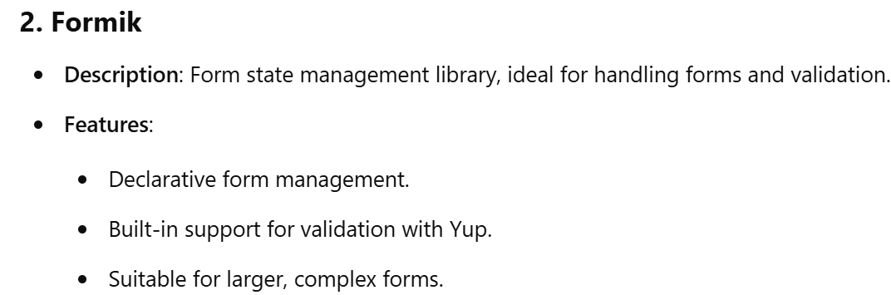
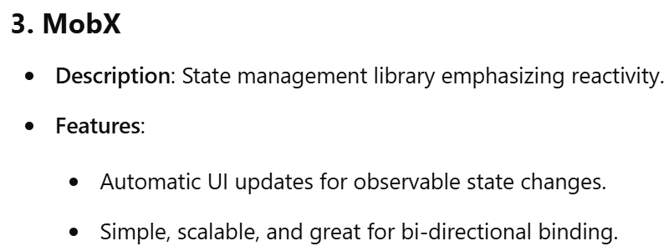
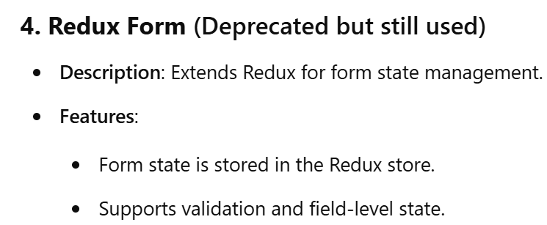
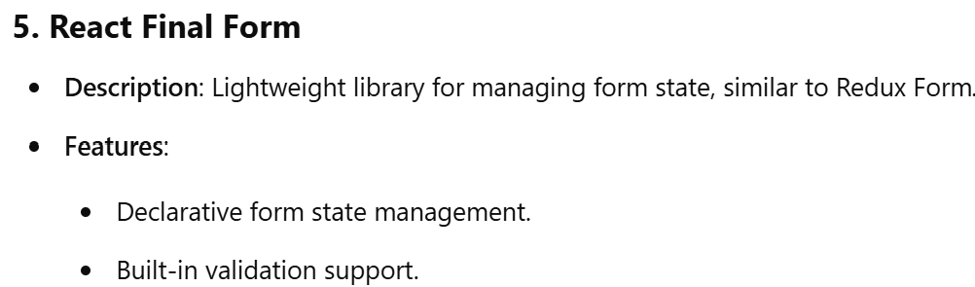
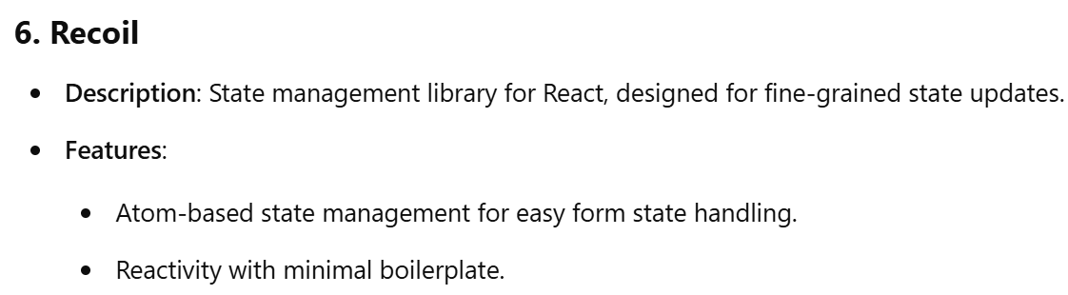


Bi-directional Bindings Frameworks, or Redux ?

Slide 61

One Framework a Day, The Doctor Away

Slide 62

Using MobX

Slide 63


MobX Store (=Model, ~Model-View pattern)

Slide 64
Exploring React Features Comparison with
const [x, setX] = useState()
return (<> text { expr } </>)
{{ expr }}
Html Rendering template in Component
Calling a child component from a Component
templating with "If" and "For"
binding properties to a Component
binding Callback
Bi-Directional Binding ?
Routing ?
More ?
return (<> <AppChild /> </>)
<app-child />
{cond && (<> </>) }
@if(..) { } @else { .. }
@for() { .. }
{items.map(i => (<> {i} </>) ) }
function AppChild({ field }) {..}
<AppChild field={expr} />
field = input();
<app-child [field]="expr">
<AppChild onX="{ () => f() }"
on={useCallback((x)=>f(x,y), [y])}>
onEvent = signal();
<app-child (onEvent)="cb()">
NOT NATIVE.. use Mobx?
<app-child
[(field)] ="parentField">
<a routerLink="/compA">
or router.navigate(['compA'])
form, i18n, animation, etc etc

Slide 65

NO native Routing in React !!

Slide 66

npm install react-router-dom

Slide 67
Exploring React Features Comparison with
const [x, setX] = useState()
return (<> text { expr } </>)
{{ expr }}
Html Rendering template in Component
Calling a child component from a Component
templating with "If" and "For"
binding properties to a Component
binding Callback
Bi-Directional Binding ?
Routing ?
More ?
return (<> <AppChild /> </>)
<app-child />
{cond && (<> </>) }
@if(..) { } @else { .. }
@for() { .. }
{items.map(i => (<> {i} </>) ) }
function AppChild({ field }) {..}
<AppChild field={expr} />
field = input();
<app-child [field]="expr">
<AppChild onX="{ () => f() }"
on={useCallback((x)=>f(x,y), [y])}>
onEvent = signal();
<app-child (onEvent)="cb()">
NOT NATIVE.. use Mobx?
<app-child
[(field)] ="parentField">
NOT NATIVE.. use react-router?
<a routerLink="/compA">
or router.navigate(['compA'])
form, i18n, animation, etc etc

Slide 68

No Form in native React ?!!

Slide 69
Exploring React Features Comparison with
const [x, setX] = useState()
return (<> text { expr } </>)
{{ expr }}
Html Rendering template in Component
Calling a child component from a Component
templating with "If" and "For"
binding properties to a Component
binding Callback
Bi-Directional Binding ?
Routing ?
More ?
return (<> <AppChild /> </>)
<app-child />
{cond && (<> </>) }
@if(..) { } @else { .. }
@for() { .. }
{items.map(i => (<> {i} </>) ) }
function AppChild({ field }) {..}
<AppChild field={expr} />
field = input();
<app-child [field]="expr">
<AppChild onX="{ () => f() }"
on={useCallback((x)=>f(x,y), [y])}>
onEvent = signal();
<app-child (onEvent)="cb()">
NOT NATIVE.. use Mobx?
<app-child
[(field)] ="parentField">
NOT NATIVE.. use react-router?
<a routerLink="/compA">
or router.navigate(['compA'])
NOT NATIVE.. do it yourself !
form, i18n, animation, etc etc

Slide 70
React PROs
React is very fashion since ~4 years
Used in lot of companies and Open-Source Projects
becoming a de-facto standard, among the top 3 frameworks: React, Angular, Vue.Js

Slide 71
React PROS
Simplistic things (no binding, no state) are possible in a simple way in React
Very easy to call stateless sub components, as Pure functions.
React forces you to use "pure" function, with exceptions to "purity"
React favors a functional approach, and encourage creating many smalll function components
TSX is compacting both the HTML and the TS/JS in the same location (is it a PROS or a CONS?)

Slide 72
React PROS (or CONS ?) React is Minimalist : only Rendering DOM
React "looks" SIMPLER than Angular, because there is almost NOTHING in it !
React is just a DOM rendering template engine
React features is a SMALL subset of Angular: "{{ exr }}" , [field]="", (event)=""
major features relies on TSX/JSX for html <-> {JavaScript} interleaving
and passing parameters in JS/TS functions

Slide 73
React CONS : no class going away from W3c CustomElement Standard
The Hook "functionalities" in React are very tricky / difficult to understand.
Example: useState(), useEffect(), useCallback() ...
They are conter intuitives, and need HUGE documentation/training to master strange effects
compared to the very SMALL features they provide
React used to have classes, but now legacy !?
... going away from Standard W3C Specification of "Custom Element" as classes

Slide 74
React CONS : Rendering with Virtual DOM
React = Only a "rendering" engine, using a Virtual DOM
very bad for memory performances : everything x2 for memory
Once upon a time, It used to be "good" to have Virtual DOM
because Microsoft Internet Explorer DOM was so bad. now useless.
Example of lighter/modern alternatives: Solid.JS, Svelte, Vue.js
Solid.JS = very similar to React TSX, but NO Virtual DOM... only real fast DOM

Slide 75
React CONS
React looks SIMPLER than Angular, because there is almost NOTHING in it !
For all features, you need additional frameworks : MOBX, Router, etc..
There is
- No Router
- No Bi-Directional Binding
- tons of frameworks, difficult to choose
- Redux is a headache, overkill
- No Form

Slide 76


Final Words
React is #1 in 2024
The Web is Absurd ... why jQuery still in 2024? rails? ... confusing SPA technologies and server-side

Slide 77
Questions ?
arnaud.nauwynck@gmail.com

